Slide 1

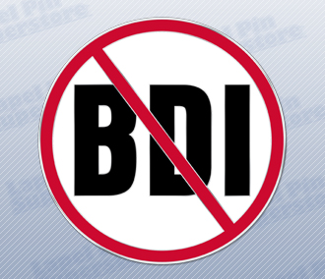
Multi-society State-of-the-Art Consensus Conference on Prevention of Bile Duct Injury During Cholecystectomy
Sponsored by:
SAGES
AHPBA
IHPBA
SSAT
EAES

Slide 2
PICO 8
Timing of Cholecystectomy in Acute Cholecystitis

Slide 3
PICO 8 Team (and PICO 11)
Waala Abelmoaty
Maria Altieri
Blaire Anderson
Saxon Conor
Chet Hammill
Scott Dolejs
Steven Strasberg
Megan Thomas

Slide 4
PICO 8 Question
Should immediate cholecystectomy (within 72 hrs from symptom onset) vs CCX delayed beyond 72 hours (< 6 weeks vs >6-12 weeks) be used for acute cholecystitis?

Slide 5
Introduction
Important Background Studies
Types of Timing Studies Available
Results of GRADE Analysis
Type A Recommendations
Type B Recommendations

Slide 6
Background: (Tornqvist et al World J Surg (2016) 40:1060)
A very important study on the relationship between severity of AC and occurrence of BDI
From clinical records and not an administrative database
Adjusted risk of bile duct injury was doubled among patients with acute cholecystitis (OR 1.97 95 % CI 1.05–3.72).

Slide 7
Background: (Tornqvist et al World J Surg (2016) 40:1060–1067)
Mild acute cholecystitis (Tokyo grade I) did not affect the risk of BDI
Moderate (Tokyo grade II) more than doubled the risk (OR 2.41 95 % CI 1.21–4.80).
Prior attacks of AC also significantly increased the odds ratio for BDI (OR 3.63 95 % CI 2.00–6.57)

Slide 8
Severity Grading of Acute Cholecystitis
Failure to consider severity grade may result in:
Imbalance in terms of severity grade with more mild or moderate severity in one group i.e., imbalance in likelihood of having BDI occur.
Inclusion of one grade over another – ie the severity grade in two groups might be equal but equally imbalanced toward mild acute cholecystitis with misleadingly low BDI rate. Not representative samples

Slide 9

How Many Timing Studies Included Severity Grading of AC?

Slide 10
How Many Timing Studies Included Severity Grading of AC?
0

Slide 11
PICO 8 Recommendation
Later we will vote on a recommendation regarding the need to grade severity of AC and history of prior attacks of AC in studies of AC and BDI

Slide 12
Background 2: Incorrect Diagnosis of AC
In patients with gallstones who come to the ED with right upper quadrant pain there may be a bias to declaring that the diagnosis is AC vs biliary colic.
This is because diagnosis affects leveling and leveling affects access to resources and perhaps payment for provider services. Generally this is thought to be innocent since the patients have an indication for cholecystectomy.

Slide 13
Background 2: Incorrect Diagnosis of AC
If the admission and discharge diagnosis by the surgeon is “acute cholecystitis” and the pathology report has the word “cholecystitis” albeit “chronic cholecystitis” there is a danger that the ICD code selected by a coder will be acute cholecystitis even though there is no acute cholecystitis.
If such patients are entered in a timing trial the early group will contain some patients that do not even have acute cholecystitis and this will bias results in favor of early cholecystectomy.

Slide 14
Diagnosis of Acute Cholecystitis by Validated Methods
Tokyo Guidelines
  1 Local sign
  1 General sign
  Radiologic confirmation
Histological examination

Slide 15
Questionable Diagnosis of AC in Published Studies
Of 13 evaluable randomized controlled trials 10 fulfilled TG criteria of 1 local sign 1 systemic signs and a radiographic confirming sign.
Of 45 evaluable observational studies 22 or just less than half fulfilled TG criteria.

Slide 16
PICO 8 Recommendation
Later we will vote on a recommendation regarding acceptable criteria for the diagnosis of acute cholecystitis in clinical studies

Slide 17
Background : Inflammation in AC and Timing of Cholecystectomy
There is a controversy regarding the timing of cholecystectomy in acute cholecystitis.
That controversy relates to the sequence of inflammatory changes that occur after onset of symptoms.

Slide 18
Background : Inflammation in AC and Timing of Cholecystectomy
In classical theory after onset of symptoms of AC there is an early period in which inflammatory conditions are favorable for cholecystectomy, an intermediate period in which conditions are less favorable, and a late period in which they become more favorable again.
Often the early period is subdivided into two periods.
In studies there is a large variation in what is considered to be early and what is considered to be late.
For consistency among studies a framework regarding these time periods would be helpful.

Slide 19
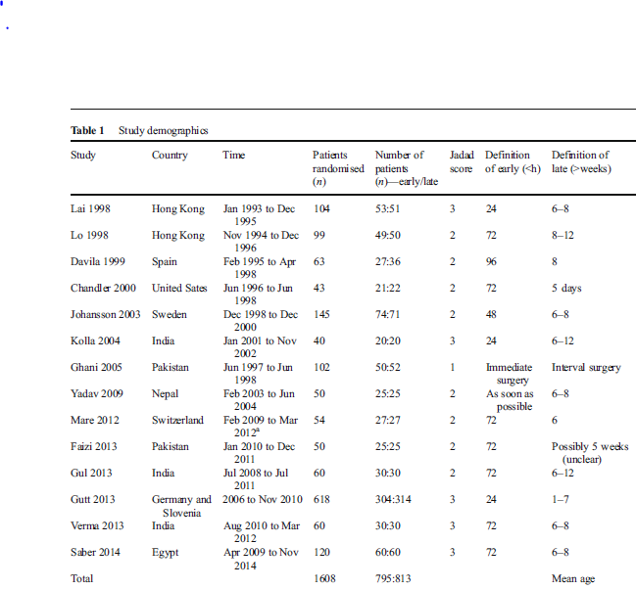
Cao et al 2015 7/14 studies chose within 72 hr as “early”
and 10/14 studies chose > 6wks as late

Slide 20
Gutt CN, et. Acute cholecystitis: early versus delayed cholecystectomy, a multicenter randomized trial.
Ann Surg 2013; 258(3):385-93.
1 of 15 papers in the MA of Cao et al
620 of 1608 (39%) in the MA of Cao et al
Early = <24hr
Late = >1 week

Slide 21
Proposed classification of interval between time of onset of symptoms and time of operation in acute cholecystitis for use in clinical studies
Phase 1. Onset of symptoms to 72 hours. Inflammation expected to be favorable for cholecystectomy - tissue swelling due to edema.
Phase 2. 72 hrs to 10 days. Inflammation expected to be less favorable for cholecystectomy. Tissue swelling and increased vascularity
Phase 3. 10 days to 6 weeks. Inflammation expected to be much less favorable for cholecystectomy – Acute and chronic inflammation.
Phase 4. 6 weeks or later. Inflammation expected to be more favorable again for cholecystectomy. Predominately chronic inflammation

Slide 22
PICO 8 Recommendation
Later we will vote on a recommendation regarding the proposed classification of time of onset of symptoms and time of operation in acute cholecystitis that should be used as a framework to guide future studies.

Slide 23
Types of Timing Studies
About 80 observational trials
About 18 RCTs
About 8 metaanalyses of RCTs
One systematic review of the metaanalyses

Slide 25
Song et al. Medicine (2016) 95:23

Slide 26
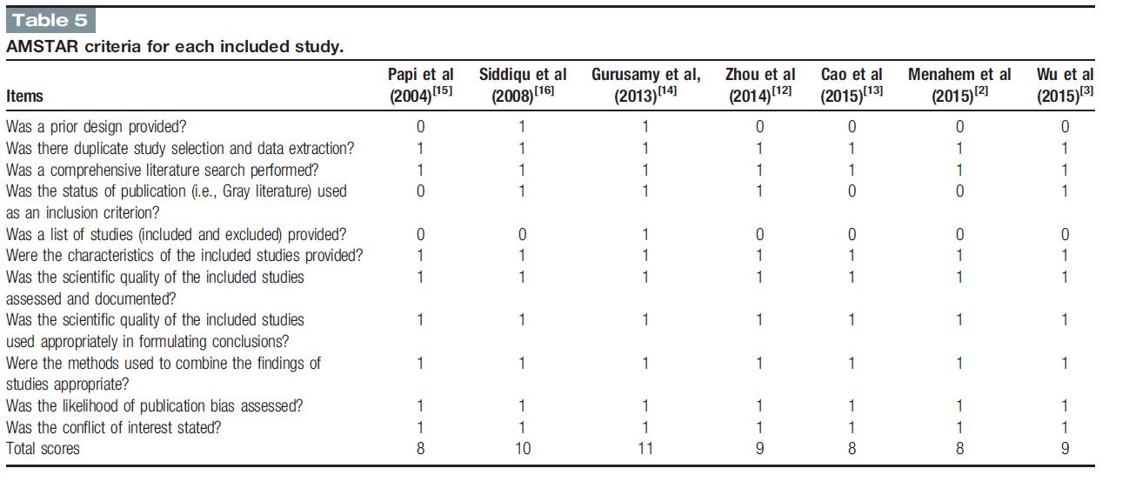
Song et al. Medicine (2016) 95:23
8
9
8

Slide 27
DeMestral et al - Ann Surg 2014
• A population-based retrospective cohort study of patients emergently admitted to hospital with acute cholecystitis and managed with cholecystectomy divided into 2 exposure groups
• Those who underwent cholecystectomy within 7 days of emergency department presentation on index admission (early cholecystectomy) and those whose cholecystectomy was delayed average of 8 weeks.
• Primary outcome was major bile duct injury requiring operative repair within 6 months of cholecystectomy.
• Propensity score methods were used to address confounding by indication.
• Early cholecystectomy was associated with a lower risk of major bile duct injury [0.28% vs 0.53%, relative risk (RR)=0.53, 95% confidence interval: 0.31-0.90.

Slide 28
DeMestral et al - Ann Surg 2014
The diagnosis of acute cholecystitis was derived by medical record abstractors who confirm the diagnosis contained in the discharge summary with medical imaging and pathology reports.
Because clinical markers of severity (eg fever, white blood cell count) and the details of imaging and pathology reports were not contained in our data sets, differentiating mild from moderate cholecystitis was not possible.
Dx by ICD code.
Severity not accounted for

Slide 29
Should
Immediate Cholecystectomy
(WITHIN 72 HOURS From SYMPTOM ONSET)
versus
Cholecystectomy Delayed Beyond 72 Hours
(BUT < 10 days AFTER SYMPTOM ONSET)
versus
Cholecystectomy Delayed Beyond 6 Weeks
versus
Cholecystectomy Delayed Beyond 12 Weeks
be used for patients with acute cholecystitis?

Slide 30
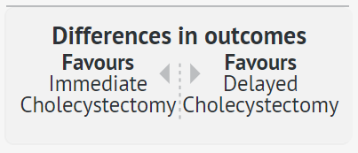
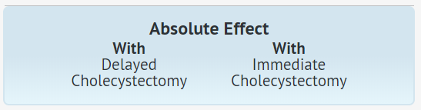
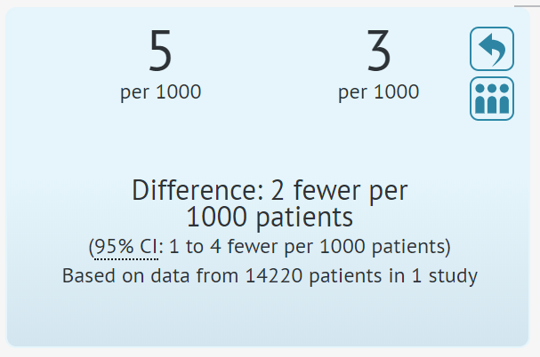
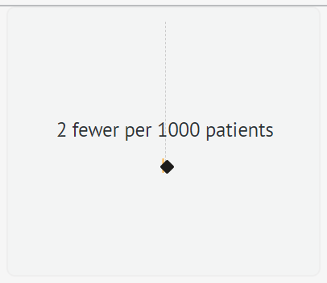
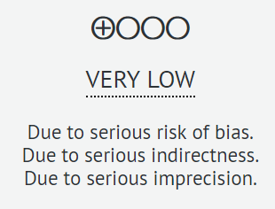
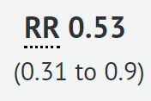
GRADE Results for Bile Duct Injury
Notes:
Serious risk of bias: acute cholecystitis diagnosed by diagnostic code and severity not taken into account
Serious indirectness: Severity was not graded increasing the risk that higher severity patients were excluded from the trials
Imprecision: Fragile data

Slide 31
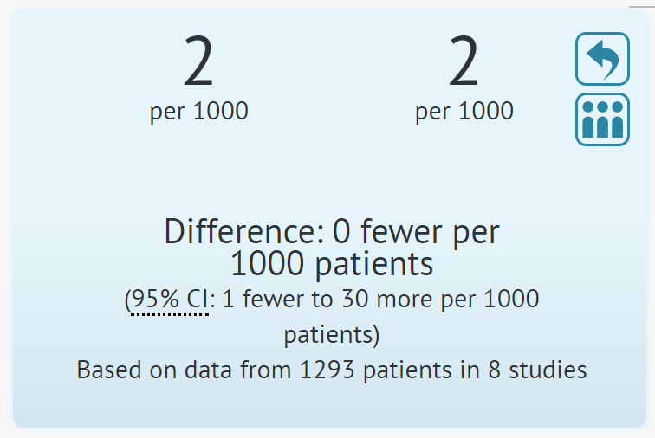
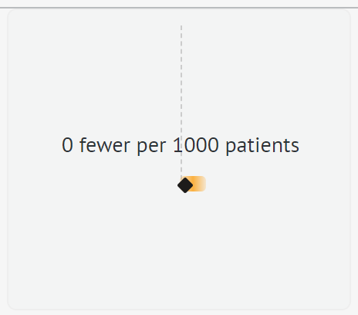
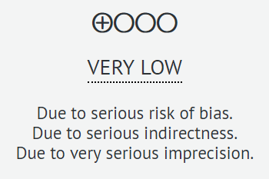
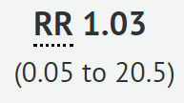
GRADE Results for Mortality
Notes:
Serious risk of bias: Moderate risk of bias across all data based on Song’s review of the available meta-analyses (Amstar score)
Serious indirectness: Severity was not graded increasing the risk that higher severity patients were excluded from the trials
Serious impression: Wide confidence intervals and sparse event rate

Slide 32
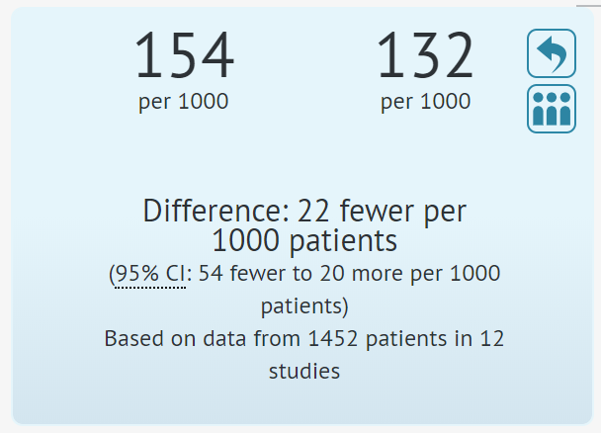
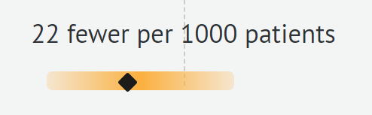
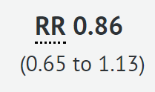
GRADE Results for Conversion
Notes:
Serious risk of bias: Moderate risk of bias across all data based on Song’s review of the available meta-analyses
Serious indirectness: Severity was not graded increasing the risk that higher severity patients were excluded from the trials
Serious impression: Wide confidence intervals and sparse event rate

Slide 33
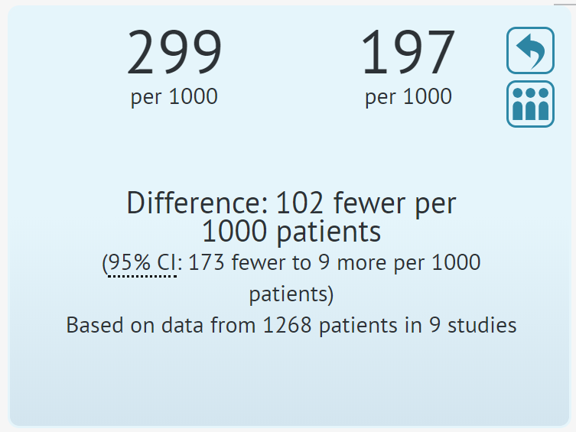

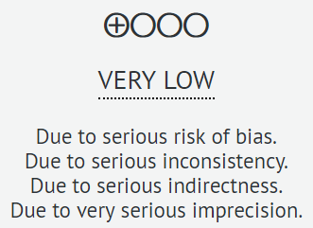
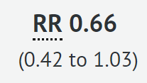
GRADE Results for Patients with Complications
Notes:
Serious risk of bias: Moderate risk of bias across all data based on Song’s review of the available meta-analyses
Serious indirectness: Severity was not graded increasing the risk that higher severity patients were excluded from the trials
Serious impression: Wide confidence intervals and sparse event rate

Slide 34
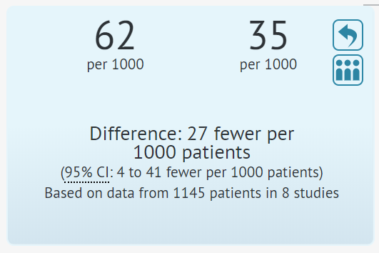
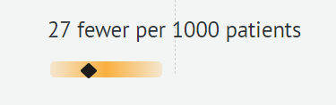
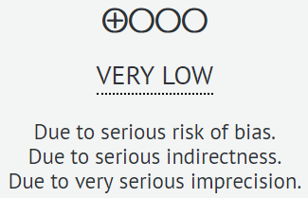
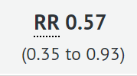
GRADE Results for Wound Infection
Notes:
Serious risk of bias: Moderate risk of bias across all data based on Song’s review of the available meta-analyses
Serious indirectness: Severity was not graded increasing the risk that higher severity patients were excluded from the trials
Serious impression: Wide confidence intervals and sparse event rate

Slide 35
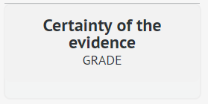
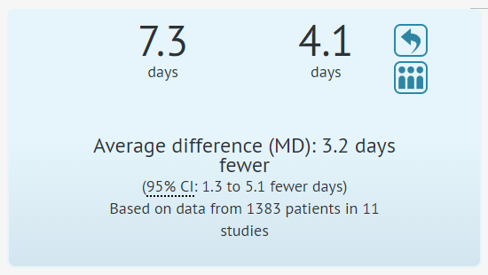
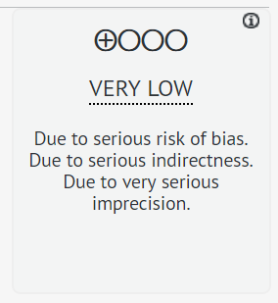
GRADE Results for Total Hospitalization
Notes:
Serious risk of bias: Moderate risk of bias across all data based on Song’s review of the available meta-analyses
Serious indirectness: Severity was not graded increasing the risk that higher severity patients were excluded from the trials
Serious impression: Wide confidence intervals and suboptimal information size

Slide 36
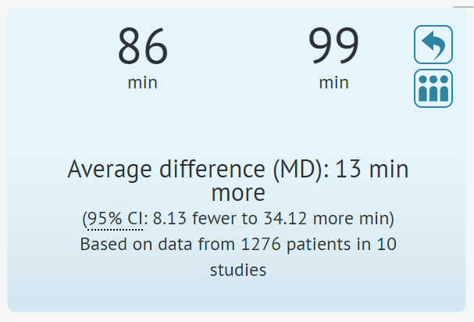
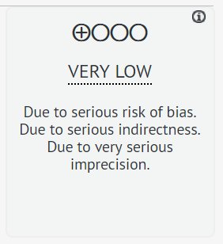
GRADE Results for Duration of Surgery
Notes:
Serious risk of bias: Moderate risk of bias across all data based on Song’s review of the available meta-analyses
Serious indirectness: Severity was not graded increasing the risk that higher severity patients were excluded from the trials
Serious impression: Wide confidence intervals and suboptimal information size

Slide 37
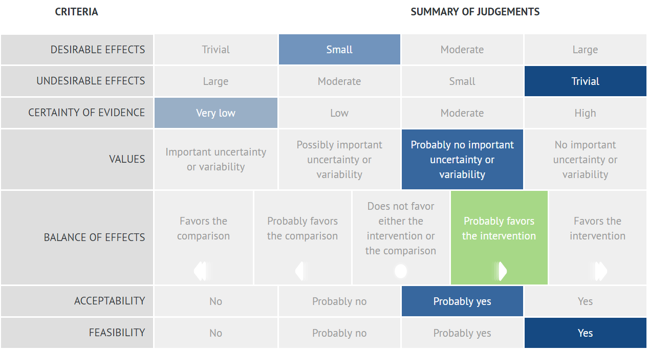
GRADE Summary of Judgements

Slide 38
Summary of PICO 8
Grade Results
Certainty: Very Low
No difference between early and late cholecystectomy in:
    Mortality
    Patients with complication
    Conversion to open cholecystectomy

Slide 39
Summary of PICO 8
Grade Results
Favors early cholecystectomy:
    Length of hospital stay
    Wound infections
Favors late cholecystectomy:
    Duration of surgery
Indeterminate
    Bile Duct Injury

Slide 40
Indeterminate - Bile Duct Injury
In MILD acute cholecystitis early versus late lap chole is unlikely to be an issue in BDI because overall rate of BDI is not increased over that in patients without acute cholecystitis
However in MODERATE acute cholecystitis the overall rate of BDI is doubled. Therefore baseline equality in Tokyo Guideline Severity Grading is needed in studies of timing of operation in acute cholecystitis.
Thus far no adequately powered timing study with the outcome measure BDI has taken severity grade into account.

Slide 41
PICO 8 Recommendations from GRADE Results (Type A)
In patients presenting with mild acute cholecystitis (according to Tokyo Guidelines), we suggest surgeons perform laparoscopic cholecystectomy within 72 hours of symptom onset (conditional recommendation, very low certainty of evidence)
For patients with moderate and severe cholecystitis there is insufficient evidence to make a recommendation, particularly as it relates to the outcome of bile duct injury.

Slide 42
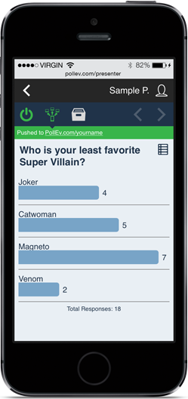
Vote on PICO 8 Recommendation

Slide 43
Other Notable Studies

Slide 44
PICO 8 Recommendations from
GRADE Results (Type B)

Slide 45
PICO 8 Recommendation 8. B1
Recommendation regarding the need to grade severity of AC and history of prior attacks of AC in studies of AC and BDI

Slide 46
PICO 8 Recommendations Type B
B1 Regarding the need to grade severity of AC and history of prior attacks of AC
Studies that examine the relationship between bile duct injury and acute cholecystitis should match patients at baseline both for severity grade of acute cholecystitis and history of prior attacks of acute cholecystitis. This recommendation is based on the finding that the incidence of major bile duct injury is significantly higher in moderate grade acute cholecystitis than in mild grade acute cholecystitis and the finding that the incidence of bile duct injury is higher in patients who have had prior attacks of acute cholecystitis than those who have not.

Slide 47
Vote on PICO 8 B1 Recommendation

Slide 48
PICO 8 Recommendation 8.B2
Recommendation regarding acceptable criteria for the diagnosis of acute cholecystitis in clinical studies

Slide 49
PICO 8 Recommendations Type B
B2 : Diagnosis of AC
The diagnosis of acute cholecystitis should be documented in future studies following well accepted clinical criteria such as TG18 diagnostic criteria or histologic findings of acute inflammation or both. If documentation of acute cholecystitis is based on diagnostic codes such as ICD codes, investigators should ensure that the diagnostic codes were based on the preceding criteria.

Slide 50
Vote on PICO 8 B2 Recommendation

Slide 51
PICO 8 Recommendation 8.B3
Recommendation regarding the proposed classification of time of onset of symptoms and time of operation in acute cholecystitis that should be used as a framework to guide future studies

Slide 52
PICO 8 Recommendations Type
B3 Regarding classification of timing of surgery in studies of acute cholecystitis
In acute cholecystitis for the purposes of reporting standardization and ability to compare results among studies, we suggest that the interval between onset of symptoms and time of operation should be defined in 4 phases (P1-4): P1: Symptom onset to 72 hrs; P2: 72 hours to 10 days; P3: 10 days to 6 weeks; P4: > 6 weeks.
We also recommend that studies define the onset of AC from the onset of patient symptoms rather than from the arrival of the patient to the hospital.

Slide 53
Vote on PICO 8 B3 Recommendation

Slide 54
PICO 11
Interval Cholecystectomy versus
No Additional Treatment in patients previously treated by cholecystostomy

Slide 55
Circumstances Indicating Cholecystostomy over Cholecystectomy at time of Presentation with Acute Cholecystitis
Type 1. Comorbidities and/or frailty (too chronically ill/too frail)
Type 2. Acute organ system failure (too acutely sick)
Type 3. Late presentation
Type 4. Resources for cholecystectomy unavailable

Slide 56
Types of Patients who are Treated by Cholecystostomy
Patients who receive cholecystostomy
Interval Cholecystectomy?
Type 1: too chronically ill/too frail
Type 2: too acutely sick
Type 3: late presentation
Type 4. resources unavailable
Probably very few will be fit enough
Some or many might be fit enough
Should be eligible for cholecystectomy
Should be eligible when resources are available

Slide 57
What would a good comparative study look like?
From all patients who got cholecystostomy tubes eliminate those who are not fit for interval cholecystectomy and randomize the remainder to interval cholecystectomy or no interval cholecystectomy

Slide 58
What would a good comparative study look like?
From all patients who got cholecystostomy tubes eliminate those who are not fit for interval cholecystectomy and randomize the remainder to interval cholecystectomy or no interval cholecystectomy
OR perhaps propensity match to eliminate patients not fit for cholecystectomy

Slide 59
What do the available studies compare?
All the patients who did not undergo interval cholecystectomy (including the too sick/ too old patients)
versus
All the patients who did undergo interval cholecystectomy.

Slide 60
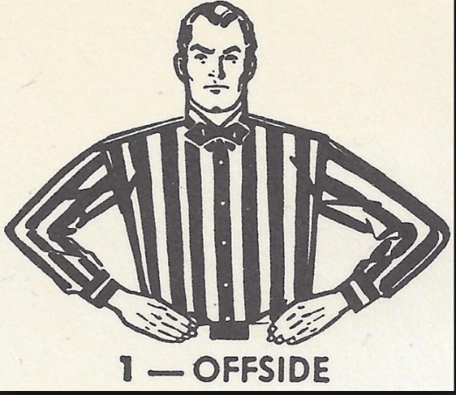
What do the available studies compare?
All the patients who did not undergo interval cholecystectomy (including the too sick/ too old patients)
versus
All the patients who did undergo interval cholecystectomy.
i.e. Unequal at baseline fault

Slide 61
What do the available studies show?
Limited number of observational studies
None have the power to draw conclusions regarding Bile Duct Injury
Notable papers
    de Mestral (2012) – 890 patients
    Alvino (2017) – 288 patients
    Jang (2012) – 93 patients
    McKay (2012) – 68 patients

Slide 62
Patients who do NOT have elective cholecystectomy
A sizeable proportion (50-80%) had no further problems after removal of tube.
Remainder had additional symptoms and some required urgent cholecystectomy often done open – suggesting increased difficulty of surgery in this group (?? Surrogate for Increased risk of BDI)

Slide 63
Patients who have elective cholecystectomy
These patients are less likely to require urgent cholecystectomy
These patients are more likely to have cholecystectomy completed laparoscopically.
So…….

Slide 64
PICO 11 Recommendations from GRADE Results
(Type A)
In low risk surgical candidates with acute calculous cholecystitis previously treated by percutaneous cholecystostomy, we suggest interval cholecystectomy after the inflammation has subsided. For high risk* candidates, we suggest a non-surgical approach that may include percutaneous stone clearance through the tube tract or tube removal and observation if the cystic duct is patent. (conditional recommendations, very low certainty of evidence).

Slide 65
Comment Regarding “High Risk”
For patients who have had a cholecystostomy tube placed and are being evaluated for elective cholecystectomy (after the acute inflammation has subsided), “high risk” is defined as substantially increased risk of mortality or morbidity associated with elective total cholecystectomy based on multidisciplinary evaluation of the patients health status including comorbidities and frailty.
The evaluation should involve surgeons, anesthesiologists and when deemed advisable other specialists depending on the patients specific health problems. The use of established risk scoring systems may be employed in reaching decisions in this setting.

Slide 66
PICO 11 Recommendations from GRADE Results (Type A)
In low risk surgical candidates with acute calculous cholecystitis previously treated by percutaneous cholecystostomy, we suggest interval cholecystectomy after the inflammation has subsided. For high risk* candidates, we suggest a non-surgical approach that may include percutaneous stone clearance through the tube tract or tube removal and observation if the cystic duct is patent. (conditional recommendations, very low certainty of evidence).

Slide 67
Vote on PICO 11 Recommendation

Slide 68
PICO 11
Interval Cholecystectomy versus
No Additional Treatment in patients previously treated by cholecystostomy

Slide 69
Laparoscopic cholecystectomy versus percutaneous catheter drainage for acute cholecystitis in high risk patients (CHOCOLATE)
Multicentre randomised clinical trial
C Loozen, H van Santvoort, P van Duijvendijk, M Besselink, D Gouma, G Nieuwenhuijzen, J Kelder, S Donkervoort, A van Geloven, P Kruyt, D Roos, A Pronk, D van der Peet, R Crolla, K kortram, V Kornmann, B van Ramshorst, T Bollen, D Boerma

Slide 70
Study design
Objective To assess whether laparoscopic cholecystectomy is superior to percutaneous catheter drainage in high risk patients with acute calculous cholecystitis
Design Multicentre, randomised controlled, superiority trial
Setting 11 hospitals in the Netherlands,
February 2011 to January 2016

Slide 71
Inclusion and exclusion criteria
Inclusion * Age > 18
Acute calculous cholecystitis
Apache-II score ≥ 7
Exclusion APACHE-II score ≥ 15
Symptoms that lasted > 7 days
Pregnancy
Decompensated liver cirrhosis
ICU admission at the time of diagnosis
Mental illness
* Adults with acute calculous cholecystitis and a high surgical risk were included. Risk assessment was based on the APACHE II score. High risk was defined as an APACHE II score of ≥ 7.

Slide 72
Randomisation
Laparoscopic Performed < 24 hours
cholecystectomy Four trocar technique
Experienced laparoscopic surgeon
Percutaenous Performed < 24 hours
drainage Transhepatic or transperitoneal route
Qualified radiologists
Drain left in place for 3 weeks

Slide 73
Outcome measures
Primary Death < 1 year
Major complications
Intra-abdominal abscess
Pneumonia
Myocardial infarction < 1 month
Pulmonary embolism
Need for re-intervention < 1 year
Recurrent biliary disease < 1 year
Secondary Individual components of primary endpoint
Minor complications
Difficulty of cholecystectomy
Utilisation of healthcare resources
Total costs

Slide 74
Statistical analysis
Sample size 284 patients
[80% power, 2-sided α 5%, loss-to follow-up 1%]
Interim analysis 50% of patients included
Adjudication committee
Premature 26 February 2016 (n = 142)
termination

Slide 75
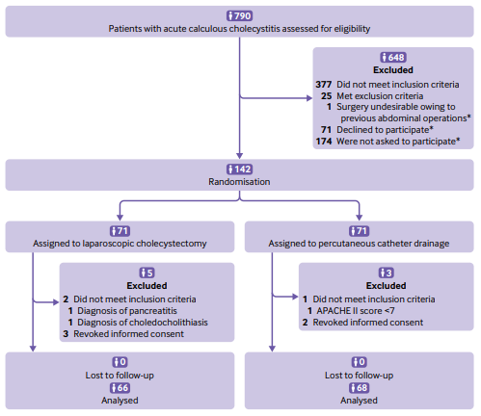
Enrollment, randomisation and follow-up

Slide 76
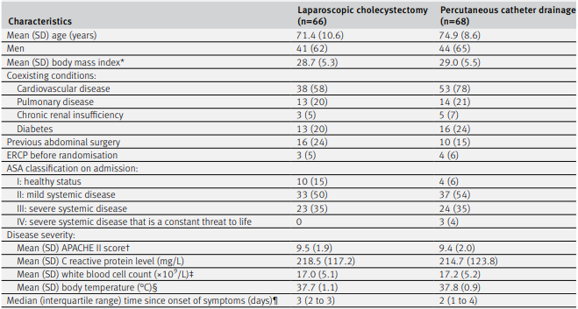
Baseline characteristics
AGE 71 75
CV disease 58% 78%

Slide 77
Primary endpoints
LC (n=66) PD (n=68) p value
Death 2 (3%) 6 (9%) 0.27
Major complications 8 (12%) 44 (65%) <0.001

Slide 78
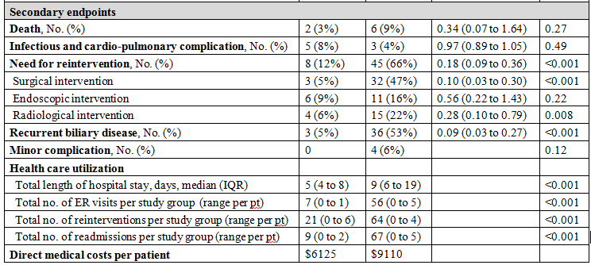
Secondary endpoints
Lap Chole Tube Risk Ratio p

Slide 79
Conclusion
Among high risk patients with acute cholecystitis, laparoscopic cholecystectomy compared with percutaneous drainage is the preferred treatment strategy from both a clinical and economical point of view.

Slide 80
Conclusion*
it should be emphasized that the results of this trial only apply to patients with an APACHE II score of 7 or more and 14 or less, and so do not apply to patients with a score of 15 or more.
During the study period, however, we only excluded 10 patients on the basis of this criterion.
This implies that virtually all patients with acute calculous cholecystitis can safely undergo early laparoscopic cholecystectomy.

Slide 81
Multi-society State-of-the-Art Consensus Conference on Prevention of Bile Duct Injury During Cholecystectomy
Sponsored by:
SAGES
AHPBA
IHPBA
SSAT
EAES

Slide 82
Work Group Five
PICO #10, 12-14
Group Leads
  Rajesh Aggarwal, MD PhD FACS FRCS, Thomas Jefferson University
  Carol-Anne Moulton, MBBS PhD FRACS, University of Toronto
Group Members
  Philip Pucher, MD PhD MRCS, Imperial College London
  Sara Monafred, MD, University of Indiana
  Nathan Stoikes, MD, University of Tennessee Health Science Centre
  Byron Fernando-Santos, MD, Dartmouth-Hitchcock Medical Center
  Ryan Campagna, MD, Northwestern University
  Romeo Ignacio, MD, Naval Medical Center San Diego

Slide 83
PICO #10
PICO 10: Should standard 4-port cholecystectomy versus reduced port laparoscopic cholecystectomy (SILS etc) versus robotic cholecystectomy versus other technique be used for limiting the risk or severity of bile duct injury in candidates for cholecystectomy?
Primary Outcome – BDI
Secondary Outcome – Operating Time, Morbidity, Conversion

Slide 84
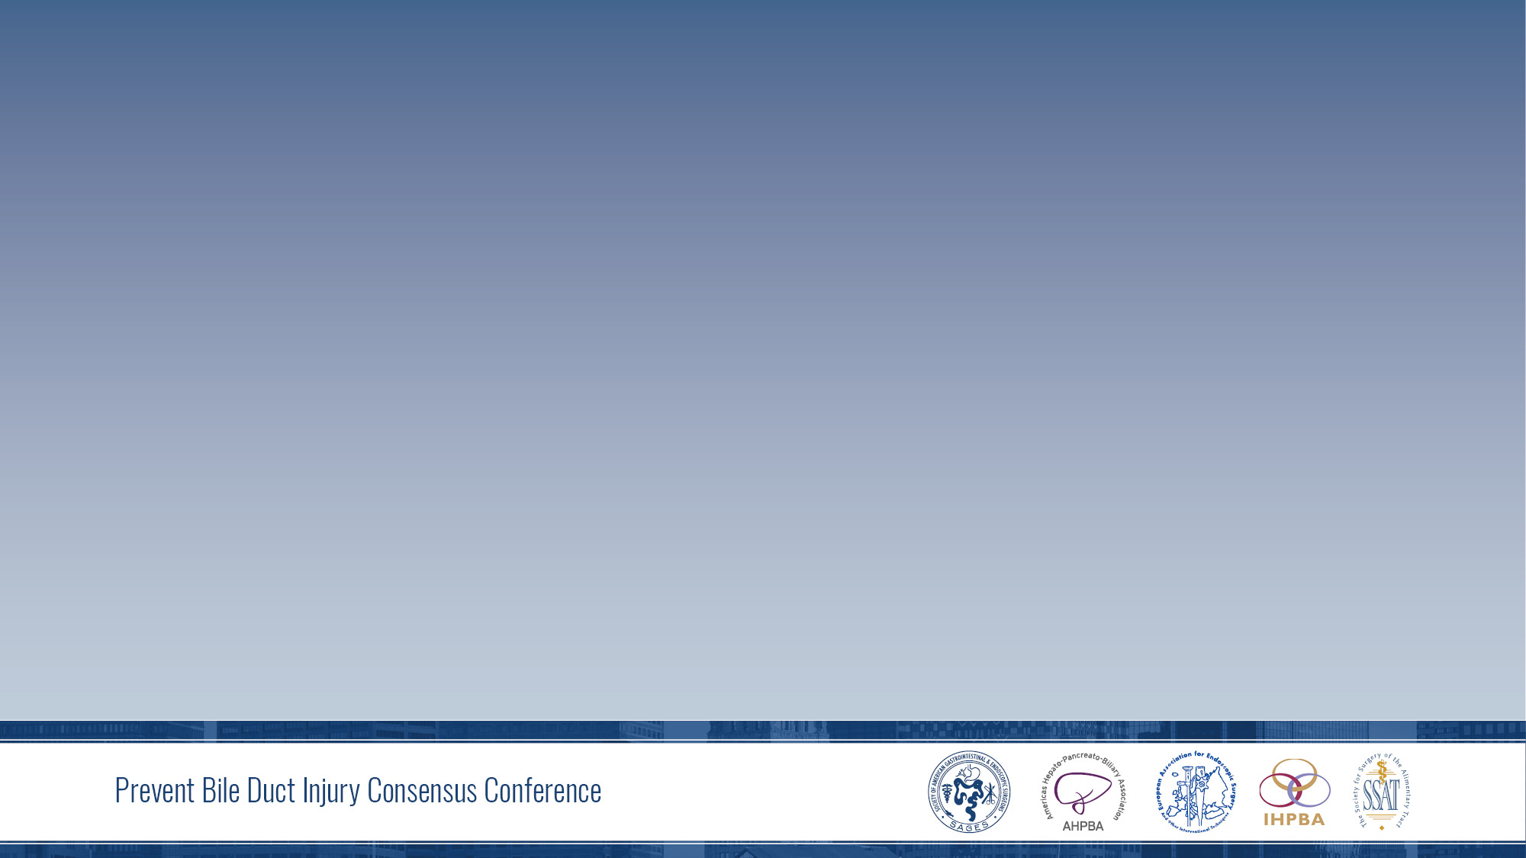
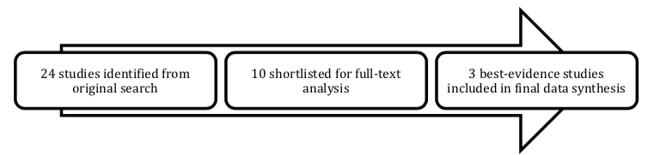
PICO #10

Slide 85
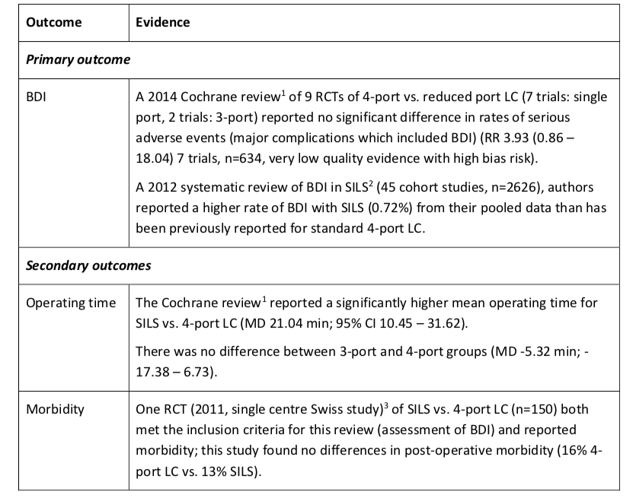
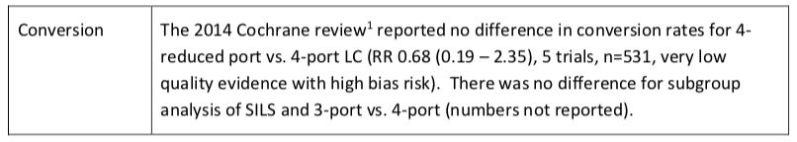
PICO #10

Slide 86
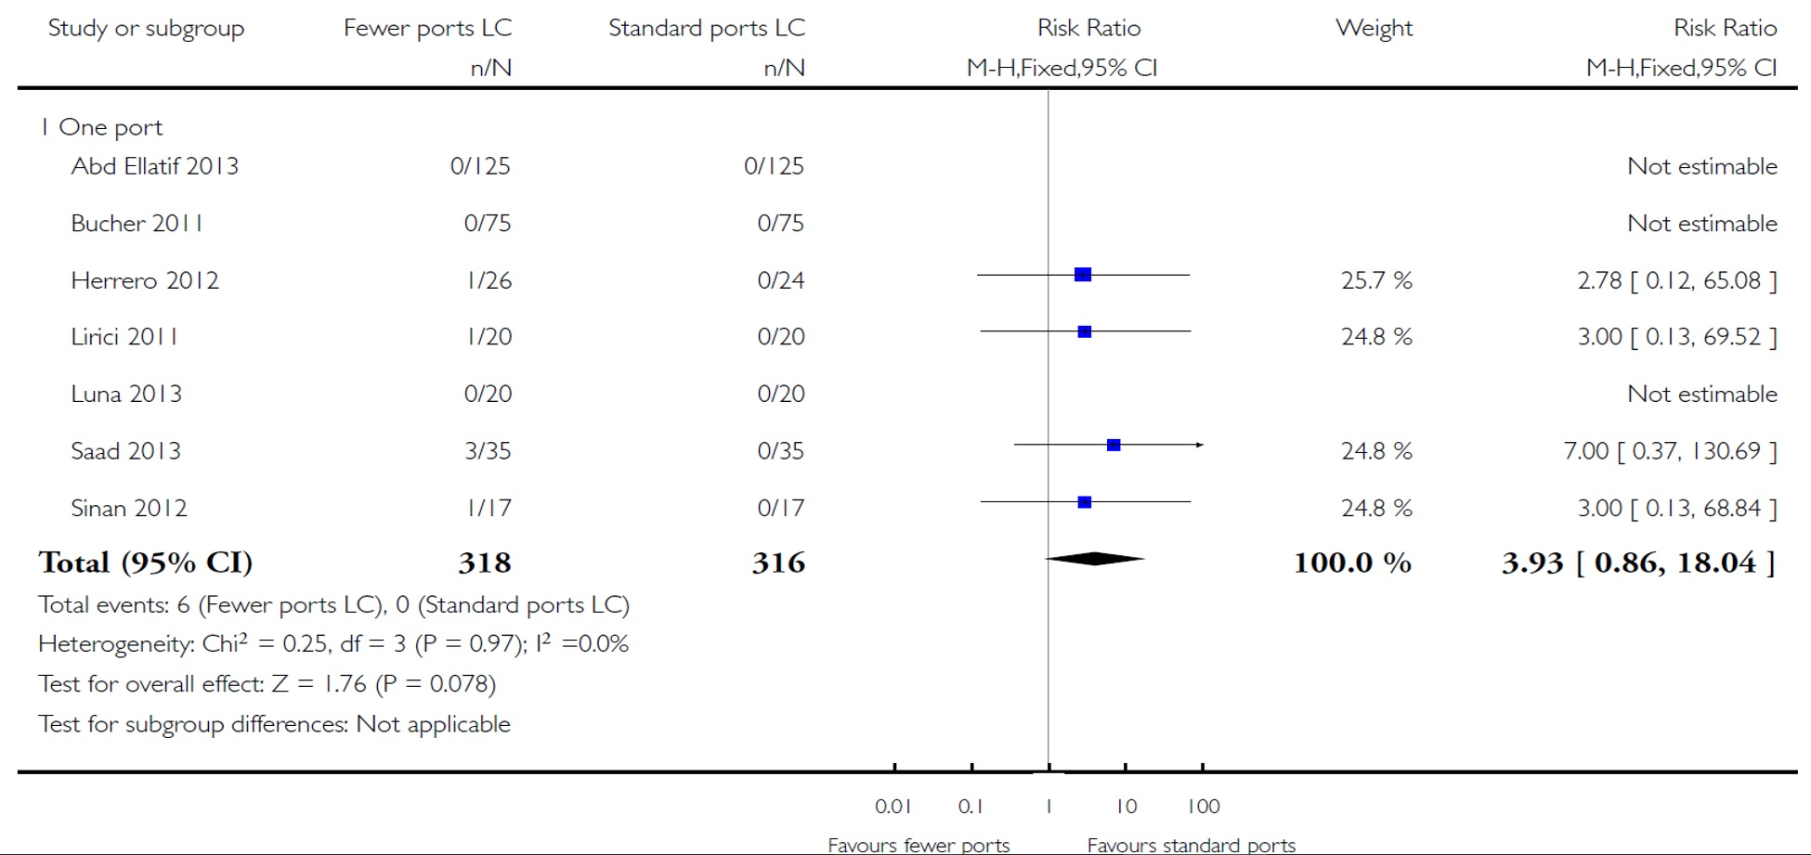
Fewer-than-four ports versus four ports for laparoscopic cholecystectomy: serious adverse events, CDSR 2014

Slide 87
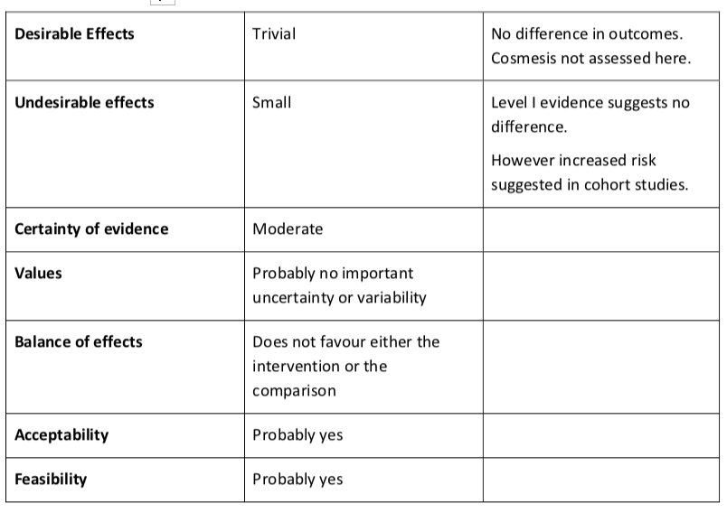
PICO #10

Slide 88
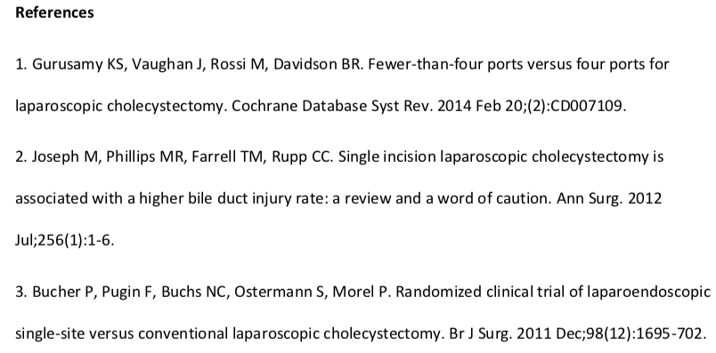
PICO #10: Recommendation
Recommendation A: For patients requiring cholecystectomy, we suggest using a multi-port laparoscopic technique instead of single port/single incision technique (conditional recommendation, very low certainty of evidence).

Slide 89
Vote on PICO 10 Recommendation

Slide 90
PICO #12
PICO 12: Should conversion of laparoscopic cholecystectomy to open cholecystectomy versus no conversion be used for limiting the risk of bile duct injury during difficult laparoscopic cholecystectomy?
No relevant data

Slide 91
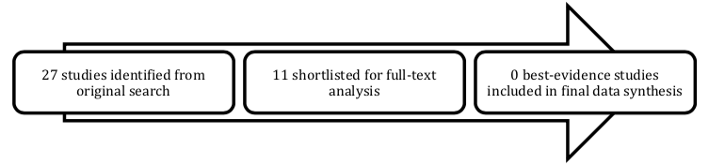
PICO #12

Slide 92
PICO #12: Recommendation B1
Current evidence is insufficient to make a recommendation in the difficult laparoscopic cholecystectomy regarding conversion vs no conversion to open cholecystectomy to limit/avoid bile duct injury.
Recommendations for future study/ type B Recommendation:
Recommendation B1: We suggest the conduct of prospective and retrospective comparisons of clinical outcomes of various ‘bail-out’ options for the difficult cholecystectomy that include conversion to open, subtotal cholecystectomy, and procedure abandonment.

Slide 93
Vote on PICO 12 B1 Recommendation

Slide 94
PICO #12: Recommendation B2
Recommendations for future study/ type B Recommendation:
Recommendation B2: We suggest the development and establishment of valid evidence for a ‘procedure difficulty score’ for laparoscopic cholecystectomy.

Slide 95
Vote on PICO 12 B2 Recommendation

Slide 96
PICO #13
PICO 13: Should surgeons take a time out to verify the critical view of safety versus no time out be used for limiting the risk or severity of bile duct injury during laparoscopic cholecystectomy?
No relevant data

Slide 97
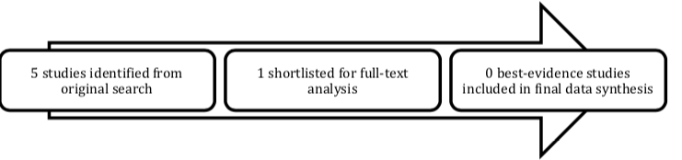
PICO #13

Slide 98
PICO #13: Recommendation
Recommendation A: Current evidence is insufficient to make a recommendation. However, as best practice, we suggest that during laparoscopic cholecystectomy, surgeons conduct a momentary pause for the surgeon to confirm in his/her own mind that the criteria for the critical view of safety have been attained before clipping or transecting ductal or arterial structures.
Recommendations for future study/ type B Recommendation:
Recommendation B: We suggest incorporation of a ‘critical view time-out’ in all prospective studies of laparoscopic cholecystectomy.

Slide 99
PICO #13: Recommendation
Recommendation A: Current evidence is insufficient to make a recommendation. However, as best practice, we suggest that during laparoscopic cholecystectomy, surgeons conduct a momentary pause for the surgeon to confirm in his/her own mind that the criteria for the critical view of safety have been attained before clipping or transecting ductal or arterial structures.

Slide 100
Vote on PICO 13 A Recommendation

Slide 101
PICO #13: Recommendation
Recommendations for future study/ type B Recommendation:
Recommendation B: We suggest incorporation of a ‘critical view time-out’ in all prospective studies of laparoscopic cholecystectomy.

Slide 102
Vote on PICO 13 B Recommendation

Slide 103
PICO #14
PICO 14: Should two surgeons versus one surgeon be used for limiting the risk of severity of bile duct injury during laparoscopic cholecystectomy?
Primary Outcome – BDI

Slide 104
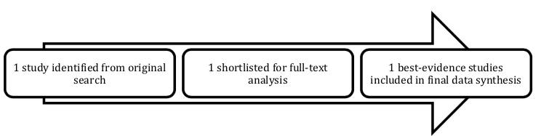
PICO #14

Slide 105
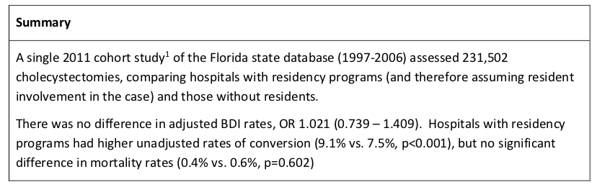
PICO #14

Slide 106
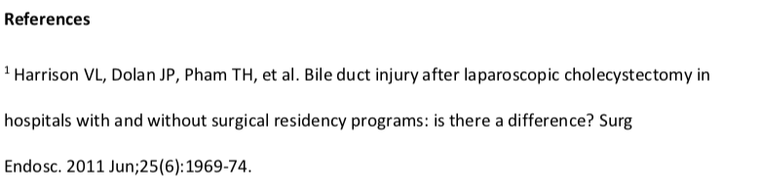
PICO #14: Recommendation
Current evidence is insufficient to make a recommendation regarding two vs one surgeons for limiting/avoiding bile duct injury in cholecystectomy.

Slide 107
Work Group Six: PICO #18
Co-leads:
    Horacio J Asbun, Jaap Bonjer, Rowan W Parks
Study Group
    Lugi Boni
    Ewan Harrison
    Oscar Imventarza
    Rohan Jeyarajah
    Francisco Leon
    Marc Mesleh
    Levam Tsalamaidze
    Eline Zwart D Asbun,

Slide 108
PICO Question #18
Referral to a specialist with experience in biliary reconstruction
vs
Reconstruction by the operating surgeon for patients with bile duct injury during laparoscopic cholecystectomy
(in the OR or early postoperative period)

Slide 109
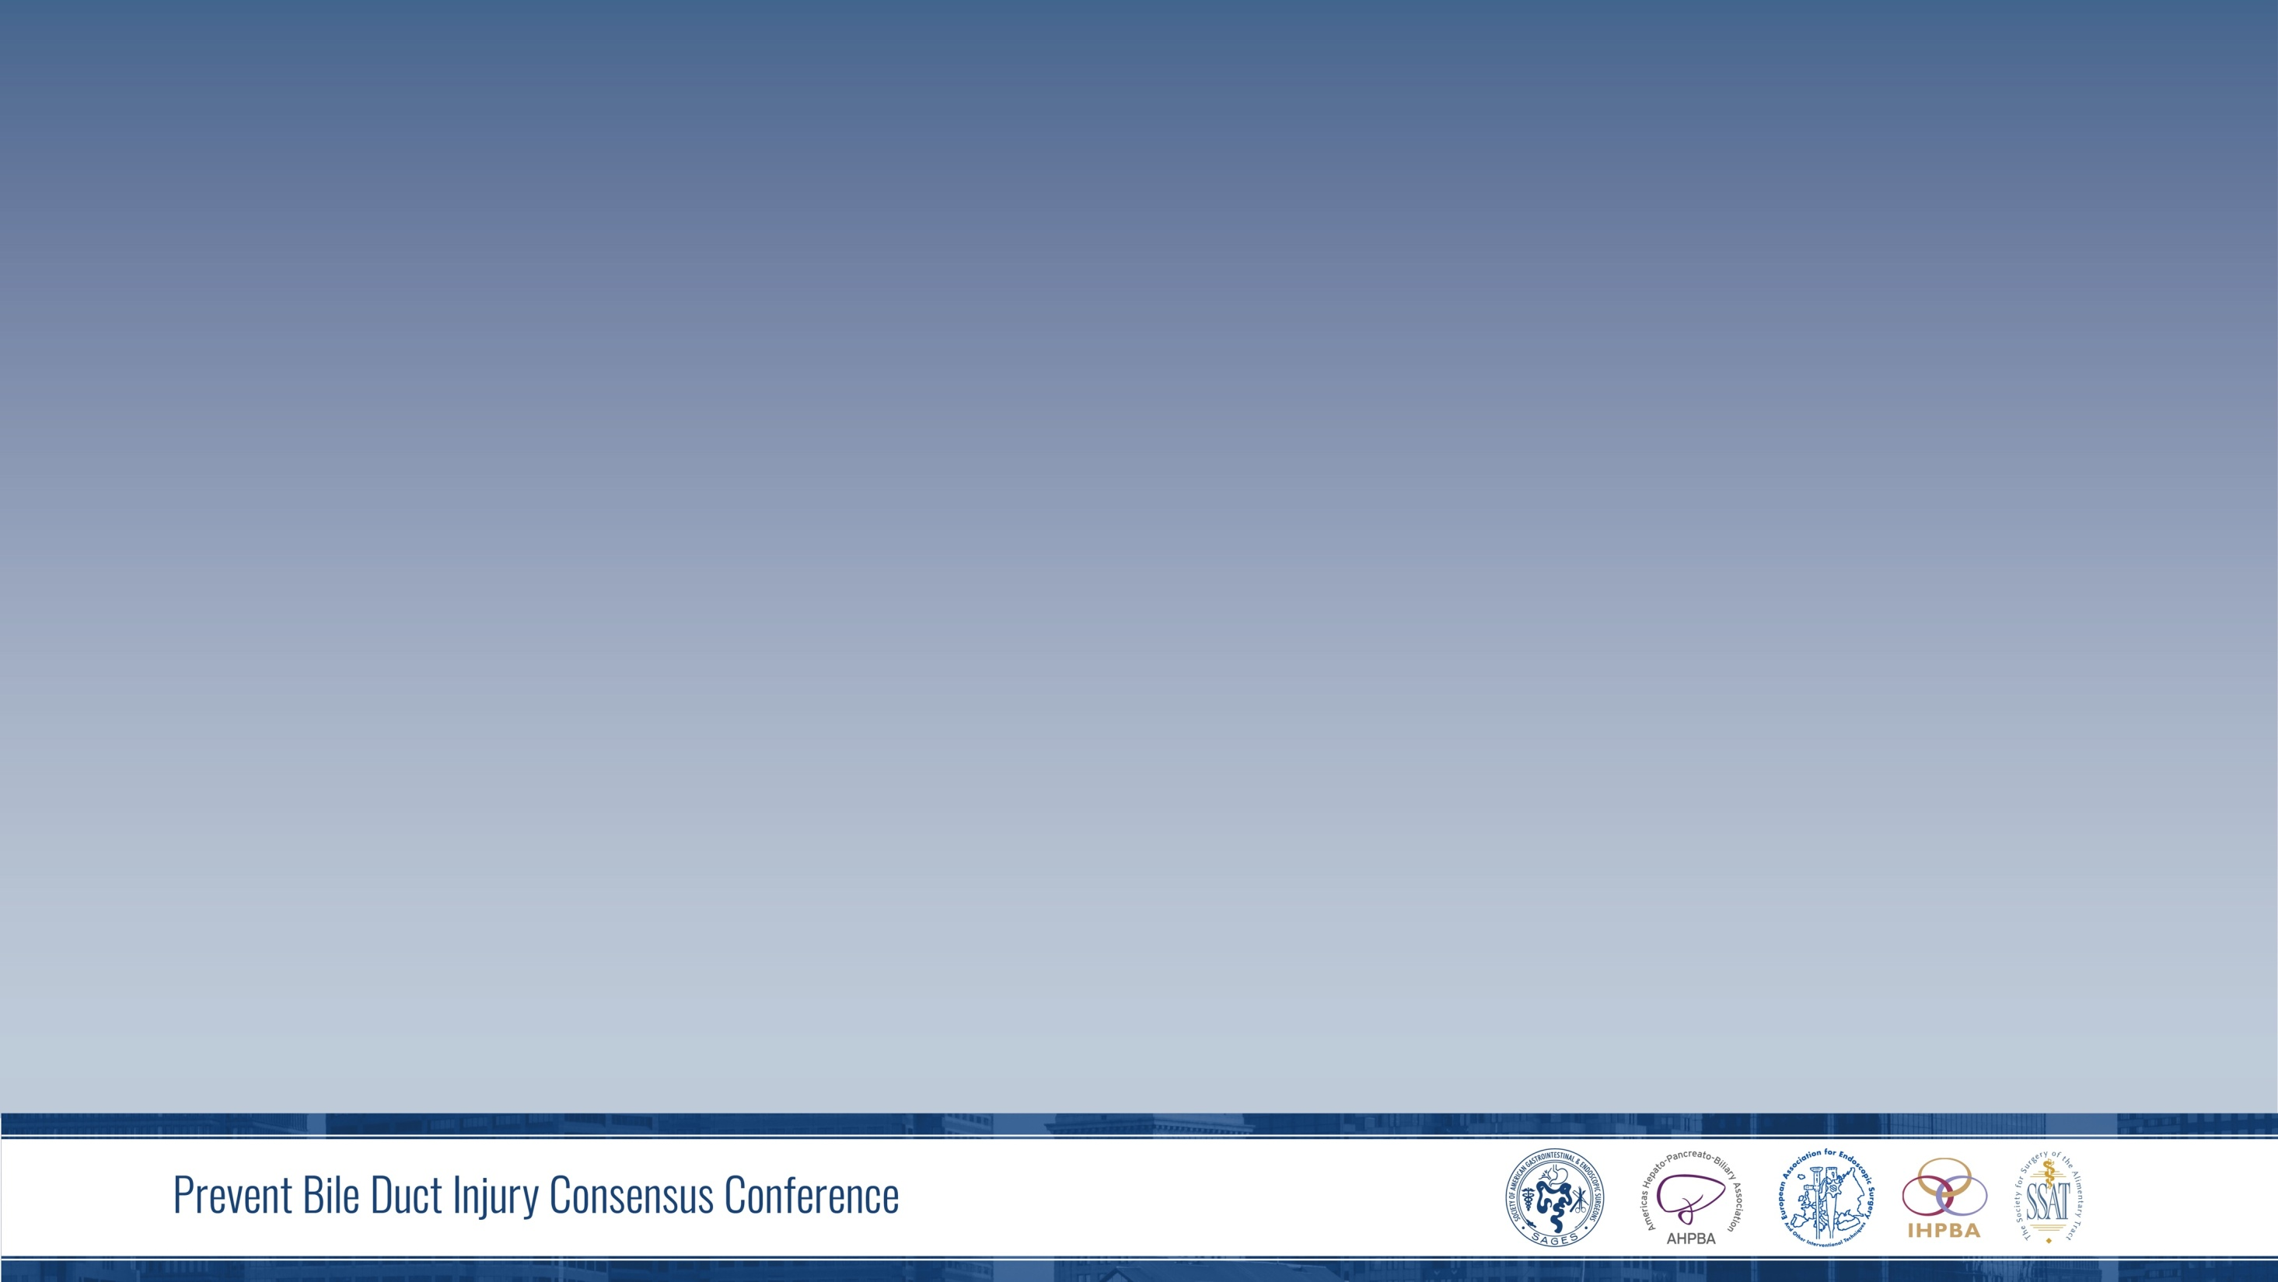
PICO #18: Recommendations
When a bile duct injury (BDI) has occurred or is highly suspected at the time of cholecystectomy or in the post-operative period, we suggest:
The patient is promptly referred to a surgeon with experience in the management of BDI, in an institution with a hepato-biliary disease multispecialty team. When not feasible to do so in a timely manner, prompt consultation with a surgeon experienced in the management of BDI should be considered.
(strong recommendation, low certainty of evidence)

Slide 110
PICO #18: Summary of Literature Reviewed
No RCTs
No systematic reviews addressing the issue
3 retrospective comparative study
44 case series
Insufficient for meta analysis
High variability of studies

Slide 111
PICO #18: Research Evidence
No Level I Evidence
Majority of studies include only patients with BDI repaired at expert centers.
Studies lack the denominator: How many patients were successfully repaired by the primary surgeon

Slide 112
PICO #18: Research Evidence
No Level I Evidence
Best studies comparing BDI primary repairs done by experts vs those referred only after failure of prior surgical attempt to repair.
  Better outcomes on patients operated primarily at expert centers

Slide 113
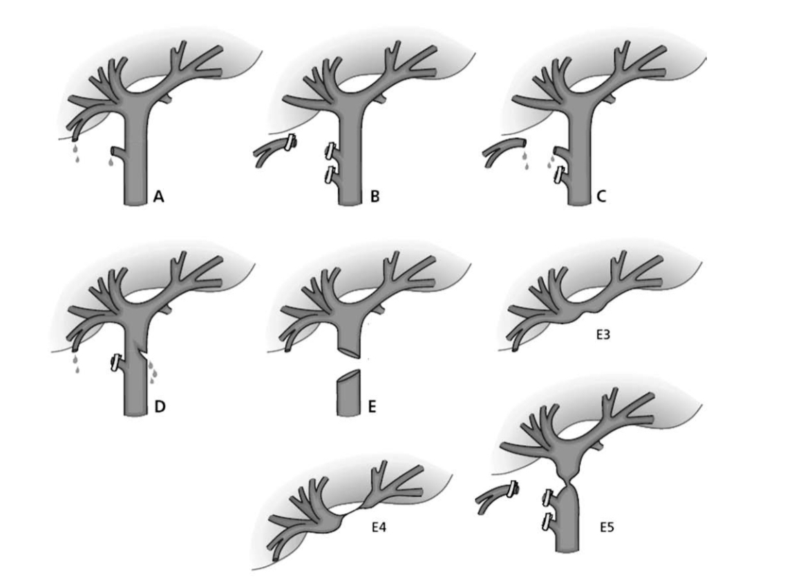
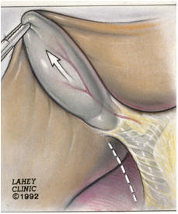
BDI: Strasberg Classification
  Asbun, Rossi et al, 1993
Nordin et. al. Scand J Surg, 2011

Slide 114
PICO #18: Research Evidence
  Perera MT et.al: Specialist early and immediate repair of post-laparoscopic cholecystectomy bile duct injuries is associated with improved long term outcome Ann of Surg 2011; 253: 553-560
Immediate and early repair by specialists after BDI
200 pts treated for major BDI w/ median f/u of 60 months
During LC: 52% anatomy described as normal 30% difficult
72% major type E injury, 13% type D
25% on-table repairs done by “outreach” team

Slide 115
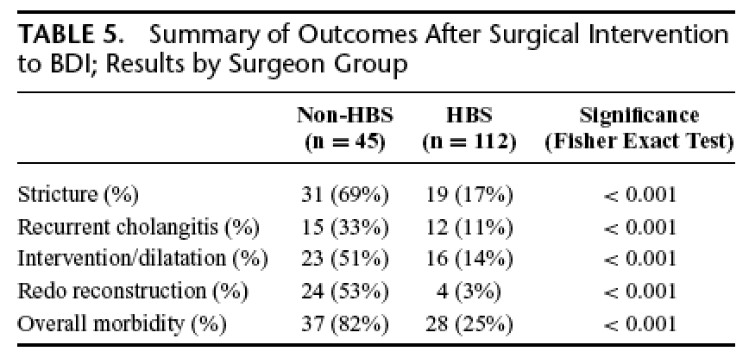
PICO #18: Research Evidence
  Perera MT et.al: Specialist early and immediate repair of post-laparoscopic cholecystectomy bile duct injuries is associated with improved long term outcome Ann of Surg 2011; 253: 553-560
Immediate and early repair by specialists after BDI

Slide 116
PICO #18: Research Evidence
  Sicklick J et.al: Surgical management of Bile Duct Injuries Sustained during laparoscopic cholecystectomy Ann of Surg 2005; 241: 786-795
Early referral to experienced multispecialty team appears to
obtain optimal results
200 pts treated for major BDI (mainly a descriptive series)
44% (81/188) outside referrals underwent sx prior to referral
58% referred within 1 month. (> incidence of bile leak, cholangitis) Median time to referral 3wks
175 pts had surgical repair: 98% R-Y hep-jej

Slide 117
PICO #18: Research Evidence
  Thomson BNJ et al: Early specialist repair of biliary injury Br J Surg 2006; 93: 216-20
Immediate repair by experienced team offers the best chance
123 BDI: 87 during LC
55 pts attempted repair prior to referral
  78% required revision
89% success rate (42/47) in experienced unit
In selected patients, early repair = delayed repair

Slide 118
PICO #18: Research Evidence
Minor Injuries
  J Rystedt et al: Bile duct injuries associated with 55,134 cholecystectomies: Treatment & Outcome from a National perspective World J Surg 2016; 40: 73-80
Repaired by operating surgeon: Short term outcomes “surprisingly good”
174 BDI in 55,134 LC (0.3%)
140/155 repaired immediately
59%Hannover Grade C 1 < 5mm lesion
17% pts had a R-Y Hep-jej

Slide 119
PICO #18: Research Evidence
Minor Injuries
  J Rystedt , AK Montgomery: Quality of life after bile duct injury: intra-operative detection is crucial: A national case-controlled study HPB 2016; 18: 1010-16.
Good QOL as long as injury is recognized during LC
168 BDI in 55,134 LC (0.3%)
Median f/u 4.3 years
59% Hannover Grade C 1 < 5mm lesion
QOL was better on those repaired immediately vs referred p<0.002)

Slide 120
PICO #3: Summary of Literature Reviewed
Justification:
Most patients will benefit from being managed by experienced multispecialty team
  BDI repair success rate
  Multi specialty team offers less invasive options
  Decreased liability
  Decreased cost
Implementation:
Education
Creation of referral/consultation pathways

Slide 121
PICO #18: Recommendations
How to implement? All involved parties
-Establishing fast tract BDI referral pathways to offer advice and contribute to immediate treatment strategies.
-Share recommendation through residency training, society guidelines, oral presentations at meetings, scientific manuscripts and incorporation of the concept:
  Referring patient implies good judgment, not a failure

Slide 122
PICO #18: Research Evidence
  Silva MA et al: Specialist outreach service for on-table repair of iatrogenic bile duct injuries - a new kind of "travelling surgeon" Ann R Coll Engl 2008; 90: 243-6
Repair of BDI as an outreach is feasible and safe
22 BDI: 20 with classical excision injury
95% had R-Y repair
2 Bile leaks, 1 transient jaundice
1 pt required transfer (associated hepatic artery injury)
14% required PTCH + dilatation 6-28m post op

Slide 123
PICO #18: Recommendations
Justification Summary
Strong clinical rationale and indirect evidence favoring specialty repair despite of very low certainty direct evidence exists addressing this question.
Complexity in assessing extent of BDI/VI and the type of surgery entailed in the repair is significantly different than LC
Experience for LC cannot be generalized to repairs of BDI.

Slide 124
PICO #18: Recommendations
Justification Summary
No concerns were noted by the panel regarding the generalizability of the systematic review evidence.
Undesirable effects secondary to a potential delay related to a specialist referral were considered small or trivial, contingent to preparing the patient well for such a referral/transfer i.e. placement of drains
Balance of benefit and harms were judged to strongly favor the intervention.

Slide 125
PICO #18: Recommendations:
When a bile duct injury (BDI) has occurred or is highly suspected at the time of cholecystectomy or in the post-operative period, we suggest:
The patient is promptly referred to a surgeon with experience in the management of BDI, in an institution with a hepato-biliary disease multispecialty team. When not feasible to do so in a timely manner, prompt consultation with a surgeon experienced in the management of BDI should be considered.
(strong recommendation, low certainty of evidence)

Slide 126
Vote on PICO 18 Recommendation

