Slide 1
Multi-society State-of-the-Art Consensus Conference on Prevention of Bile Duct Injury During Cholecystectomy
Sponsored by:
SAGES
AHPBA
IHPBA
SSAT
EAES

Slide 2
PICO 4: Should intraoperative biliary imaging (e.g. intraoperative cholangiography, ultrasound) versus no intraoperative biliary imaging be used for limiting the risk or severity of bile duct injury during laparoscopic cholecystectomy?
Leads: Adnan Alseidi, Mike Ujiki, Michael Brunt
Alessandro Paganini
Tim Schaffner
Eugene Ceppa
Sadiq Sikora
Sara Holden
Shanley Deal
Bailey Su

Slide 3
PICO 4
PICO 4: Should intraoperative biliary imaging (e.g. intraoperative cholangiography, ultrasound) versus no intraoperative biliary imaging be used for limiting the risk or severity of bile duct injury during laparoscopic cholecystectomy? Main Outcome: Bile duct injury and severity Proxy outcomes: Quality of the CVS, Conversions, Complications (major/minor), Mortality Reviewers comments: intraoperative cholangiography/ultrasound vs no imaging

Slide 4
PICO 4: Recommendation
Intraoperative biliary imaging (in particular IOC) should be used during cholecystectomy to prevent or limit the severity of bile duct injury in patients with unclear biliary anatomy or suspicion of bile duct injury (strong, low evidence)
We suggest the liberal use of IOC during cholecystectomy to prevent or limit the severity of bile duct injury in patients with acute cholecystitis or a history of acute cholecystitis, (conditional, low evidence)
For surgeons with appropriate experience and training, laparoscopic ultrasound imaging is an appropriate alternative to IOC.

Slide 5
PICO 4: Justification
Randomized trials have been underpowered to answer the question
Meta-analysis of large studies favors IOC over no IOC in most of adjusted studies
Large prospective Swedish database study showed intent to use IOC was associated with lower rate of BDI in acute cholecystitis and history of acute cholecystitis only. Other studies have shown a higher rate of BDI in patients with acute cholecystitis.
In multiple studies, IOC use is associated with increased rate of intraoperative recognition of BDI when it occurs (quality of evidence low but is a consistent finding across multiple studies). The potential benefit is early recognition and avoidance of potentially increasing the severity of BDI.
Laparoscopic ultrasound appears to show accurate anatomic identification but requires experience and expertise for appropriate use and interpretation of anatomy.

Slide 6
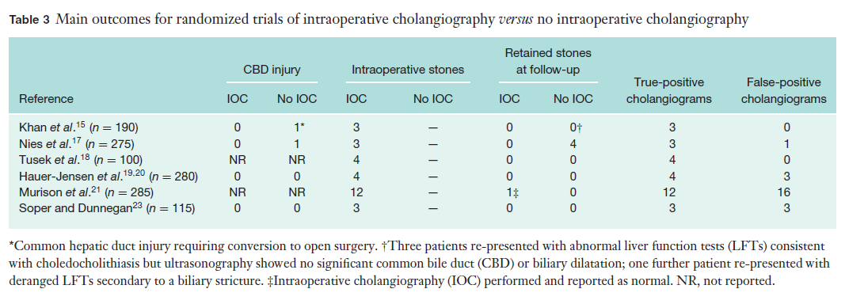
Randomized Trials of IOC vs No IOC: Ford JA et al Br J Surg 2011 R-AMSTAR Score: 31.5
There were 2 major BDIs in 1715 patients.
Overall BDI rate was 0.2% and major BDI rate 0.1%.
Notes:
Studies selected per PRISMA statement. 6 of trials were early to mid 1990’s

Slide 7
Randomized Trials of IOC vs No IOC in Lap Chole
Study | N | BDI IOC | BDI No IOC
Khan et al | 190 | 0 | 1
Nies et al | 275 | 0 | 1
Tusek et al | 100 | NR | NR
Hauer-Jenson et al | 280 | 0 | 0
Murison et al | 285 | NR | NR
Soper et al | 115 | 0 | 0
Arnott et al | 303 | 1 | 1
Sharma et al | 167 | NR | NR
Ding et al** | 371 | 1 | 1
Total | 2086 | 2 | 4
**Not reviewed in Ford et al

Slide 8
Systematic Review of Randomized Trials of IOC vs No IOC: Ford et al Br J Surg 2011 R-AMSTAR Score: 31.5
Mortality: N=4 trials.
5 deaths in the IOC group and 3 in the non-IOC group
None of the deaths were directly attributable to surgery
Morbidity: N=5 trials
One of open cholecystectomy showed higher morbidity rate in the IOC group (14.8% versus 5.8%) – Hauer-Jensen.
Another study showed a slightly higher rate of wound sepsis in the IOC group (7.6% versus 5.2% - Murison 1993.
Summary:
Level 1 evidence for IOC was of poor or moderate quality
No robust evidence to support or abandon the use of IOC to prevent retained CBD stones or bile duct injury.
They also concluded that further small trials were not recommended.

Slide 9
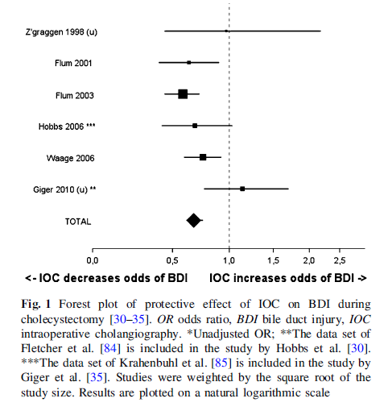
Systematic Reviews: Buddingh KT et al Surg Endosc 2011; 25: 2449-2461. R-AMSTAR Score: 24
Systematic review of articles that looked at bile duct visualization techniques for the prevention of BDI during lap chole
Population based studies > 10,000 pts; most from 1990’s
Studies prone to bias and confounders as they relied heavily on administrative data or very heterogeneous groups.
In some cases, IOC could have been performed only because a BDI was suspected or observed. As result, the number of BDIs that were identified when IOC was used could have been higher than the true incidence.
Forest Plot of Protective Effect of IOC

Slide 10
PICO 4: Meta-analysis IOC vs No IOC and BDI
Analysis of 14 large studies of mostly administrative data of 2,540,700 cholecystectomies
Studies at mod-high risk of bias
Odds Ratio for IOC vs no IOC and BDI:
Overall: 0.78 (0.63-0.96)
Adjusted: 0.81 (0.62-1.07)

Slide 11
Swedish Gallriks prospective database study of 51,404 cholecystectomies
Intent to use intraoperative cholangiography assoc. reduced risk of BDI in acute cholecystitis and Hx acute cholecystitis
Group | Adjusted Odds Ratio | Adjusted Odds Ratio w/ instrument variable
All patients | 0.76 (0.62, 0.93) | 0.80 (0.62-1.04)
Acute cholecystitis | 0.44 (0.30, 0.63)* | 0.50 (0.32-0.77)*
History acute chole | 0.59 (0.35, 1.00)* | 0.70 (0.37-1.34)*
No acute cholecystitis | 0.97 (0.74, 1.25) | 1.06 (0.75-1.49)
Tornqvist B et al. BMJ; 2015; 102: 950-958

Slide 12
Meta-analysis of IOC vs No IOC and Diagnosis of BDI Intraoperatively
Meta-analysis of 8 studies of 1256 BDI’s comparing IOC vs no IOC and intraop recognition of injury
Odds ratio: 2.92 (95% CI 1.55-5.68) favoring IOC (p=0.014)

Slide 13
Laparoscopic Ultrasound Studies Systematic Review: Buddingh KT et al Surg Endosc 2011; 25: 2449-2461. R-AMSTAR Score: 24
Success rate of LUS and IOC both over 90% (Machi 1999)
Retrospective cohort study (Biffl) found 11 BDIs in 594 cases without LUS vs 0 in 248 cases with LUS. (p =0.04).
Prospective multicenter cohort study by Machi (2009) reported no BDI and only 3 bile leaks in 1381 patients.
Conclusions: US shows excellent results in delineating biliary anatomy

Slide 14
PICO 4 Summary of Judgments

Slide 15
PICO 4: Recommendation
In patients with uncertainty of biliary anatomy or suspicion of bile duct injury during laparoscopic cholecystectomy, we recommend that surgeons use intraoperative biliary imaging (in particular intraoperative cholangiography) to mitigate the risk of bile duct injury (strong recommendation, low certainty of evidence).
In patients with acute cholecystitis or history of acute cholecystitis, we suggest the liberal use of intraoperative cholangiography during laparoscopic cholecystectomy to mitigate the risk of bile duct injury (conditional recommendation, low certainty of evidence)
Surgeons with appropriate experience and training may use laparoscopic ultrasound imaging as an alternative to IOC during laparoscopic cholecystectomy.

Slide 16
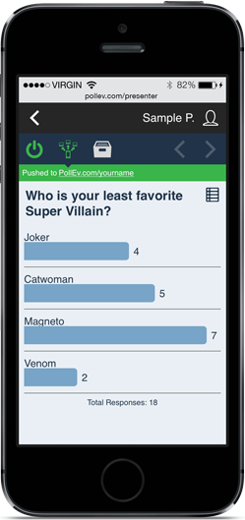
Vote on PICO 4 Recommendation

Slide 17
PICO 5
PICO 5a: Should intraoperative infrared biliary imaging versus IOC biliary imaging be used for limiting the risk or severity of bile duct injury during laparoscopic cholecystectomy? PICO 5b: Should intraoperative infrared biliary imaging versus white light biliary imaging be used for limiting the risk or severity of bile duct injury during laparoscopic cholecystectomy Main Outcome: Bile duct injury (incidence or change in severity) Proxy outcomes: Quality of the CVS, Conversions, Complications (major/minor), Mortality

Slide 18
PICO 5: Recommendations:
Current evidence is insufficient to make a recommendation regarding use of near infrared cholangiography for identification of biliary anatomy during cholecystectomy compared to intraoperative cholangiography or white light.
The evidence should be reassessed once results of the large randomized trial are available (NCT02702843)

Slide 19
PICO 5: Type B Recommendation:
Near infrared cholangiography should be assessed in large trials compared to white light and/or intraoperative cholangiography with risk stratification and risk adjustment. In particular, this technology should be studied in difficult cholecystectomy patient populations that includes those with acute cholecystitis or a history of acute cholecystitis, severe chronic cholecystitis, and obese patients.

Slide 20
PICO 5: Justification:
Multiple small studies, most are not comparative
Comparative studies though small suggest a trend toward enhanced identification of CD and CBD with NIRC compared to IOC
Studies are inconclusive regarding the additional benefit of infrared cholangiography in comparison to conventional white light.
Studies are not risk adjusted and NIRC inadequately studied in higher risk populations (obese patients, acute cholecystitis)
Large randomized industry sponsored trial (NCT02702843) completed –results pending

Slide 21
PICO 5: Overview
Systematic reviews – 5
Randomized controlled trials: 0
Prospective cohort studies: 11
Retrospective cohort studies: 0
Case series: 2

Slide 22
Systematic Review 1: Vlek SR et al Surg Endosc 2016: R-AMSTAR-29
Most studies examined were prospective cohort studies and highly subject to bias
Most studies did not compare ICG visualization intraoperatively to conventional white light
The population studied were heterogeneous. For studies that looked at both complicated and uncomplicated gallstone disease, biliary visualization was pooled for these.
Different definitions for uncomplicated and complicated gallbladder disease were used between the studies.
Other considerations for use of ICG verses IOC. IOC costs more, has greater radiation exposure, higher technical failure, potentially challenging perioperative logistics, and risk of biliary injury from cannulation. ICG can provide imaging before the start of dissection and can be used multiple times without additional risk to the patient

Slide 23
Systematic Review 1: Vlek SR et al Surg Endosc 2016: GRADE Summary of Evidence
GRADE Summary of Evidence (Table 4)
Outcomes | Anticipated absolute effects* (95% CI) Risks with IOC | Relative effect (95% CI) Risk w ICG | No Participants | Quality of evidence | Comments
Cystic duct | study population 837 per 1000 | RR 1.16 (1.00-1.35) 971 per 1000 (837-1000) | 430 (four observational studies) | moderate | Down graded for imprecision
CBD | study population 851 per 1000 | RR 1.00 (0.97-1.03) 851 per 1000 (826-877) | 430 (for observational study | moderate | Down graded for imprecision
CHD | study population 793 per 1000 | RR 0.76 (0.58-1.01)603 per 1000 (460-801) | 300 (3 observational studies) | low | Down graded for imprecision and serious risk of bias

Slide 24
Systematic Review 2: Pesce A et al World J Gastroenterol 2015: R-AMSTAR-27
Sixteen studies were reviewed from 2009-2014. The study populations were NIR during standard lap chole N= 11, single incision robotic cholecystectomy N= 3, multiport robotic cholecystectomy N= 1, and single incision lap chole N= 1. The only study not reviewed in Vlek is Dasalaki 184 robotic lap choles.
Detection rates of structures (weighted averages)
 | Cystic duct | CHD | CD-CHD junction | CBD | Cystic artery
N = 590 pts | 96.2 (94.7.97.7) | 78.1 (74.8-81.4) | 72.0 (69.0-75.0) | 86.0 (83.3-88.8) | 69.4 (61.8-77.1) *
Acute cholecystitis (2 studies, | 91.6-94.5% | 79.1-57.0% | 75%^ | 79.1-72.0%

Slide 25
WG2 PICO 5 Meta-analysis: Near-infrared cholangiography vs IOC

Slide 26
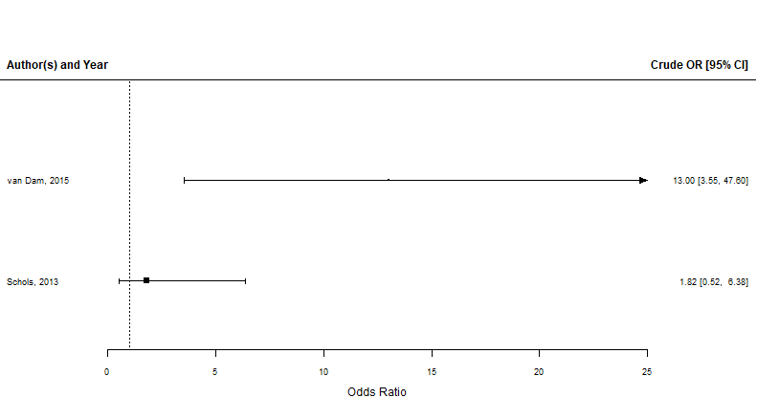
WG2 PICO 5 Meta-analysis: Near-infrared cholangiography vs White Light
Cystic Duct ID
CBD ID

Slide 27
Multicenter Randomized Trial (NCT02702843)
Trial design: Prospective randomized trial to compare lap cholewith near infrared fluorescent cholangiography (NIRC) vs conventional lap chole
Enrollment: 603 pts
Outcomes: ID biliary structures, CVS visualization, cystic duct/artery to GB, surgical time, BDI, complications, etc
Sponsor: Karl Storz Endoscopy

Slide 28
PICO 5: Summary of Judgments

Slide 29
PICO 5: Recommendations:
Current evidence is insufficient to make a recommendation regarding use of near infrared cholangiography for identification of biliary anatomy during cholecystectomy compared to intraoperative cholangiography or white light. The evidence should be reassessed once results of the large randomized trial become available (NCT02702843)

Slide 30
PICO 5: Type B Recommendation:
Near infrared cholangiography should be assessed in large trials compared to white light and/or intraoperative cholangiography with risk stratification and risk adjustment. In particular, this technology should be studied in difficult cholecystectomy patient populations that includes those with acute cholecystitis or a history of acute cholecystitis, severe chronic cholecystitis, and obese patients.

Slide 31
Vote on PICO 5 Recommendation

Slide 32
PICO 6 and 7
Taylor Riall and Dana Telem
Workgroup: Ryan Campagna, Dan Hashimoto, Chris Davis, Marie Crandall, Chantal den Bakker, Leonie van Gastel, Charles Lawrence

Slide 33
PICO 6: Question
Should surgical (complexity) risk stratification vs alternative or no risk stratification be used for mitigating the risk of BDI associated with laparoscopic cholecystectomy?
Primary outcome: Bile duct injury

Slide 34
Recommendation 1
We suggest that surgeons use the Tokyo Guidelines 18 (TG18) for grading and management of patients with acute cholecystitis.
(conditional recommendation, low certainty of evidence)

Slide 35
Recommendation 2
During operative planning of laparoscopic cholecystectomy and intraoperative decision-making, we suggest that surgeons consider factors that potentially increase the difficulty of laparoscopic cholecystectomy (such as male gender, increased age, chronic cholecystitis, obesity, liver cirrhosis, adhesions from previous abdominal surgery, emergency cholecystectomy, cystic duct stones, enlarged liver, cancer of gallbladder and/or biliary tract, anatomic variation, biliodigestive fistula, and limited surgical experience).
(conditional recommendation, very low certainty of evidence)

Slide 36
Study Review
We reviewed 18 articles, some only tangentially relevant. These included:
3 systematic reviews,
1 case-control study
4 prospective cohort studies
9 retrospective comparative cohort studies
1 case series

Slide 37
Study Review
No article DIRECTLY addressed the PICO question by comparing the incidence of BDI when a risk stratification system was used vs. not used.

Slide 38
Evidence: Acute Cholecystitis Increases Risk of BDI
There is evidence to indicate that the presence of acute cholecystitis increases the risk of mortality as well as BDI, as well as evidence that this risk increases with the severity of inflammation as proposed by the TG 13/18.

Slide 39
Evidence: Acute Cholecystitis Increases Risk of BDI
Best evidence is from a case-control study, derived from a population-based clinical database
Matched 158 BDI patients to 623 controls
One of the few studies to use the TG13 criteria to grade severity of cholecystitis
Tvornquist et al. World J Surg. 2016;40:1060–1067.

Slide 40
Evidence: Acute Cholecystitis Increases Risk of BDI
The adjusted risk of bile duct injury doubled among patients with acute cholecystitis (OR 1.97 95 % CI 1.05–3.72)
Risk increased as inflammation increased
Tokyo grade I: (OR 0.96 95 % CI 0.41–2.25)
Tokyo grade II: (OR 2.41 95 % CI 1.21–4.80)
Tokyo grade III; (OR 8.43 95 % CI 0.97–72.9)***
The mortality rate was 5.4% for grade III, 0.8% for grade II, and 1.2% for grade I cholecystitis (not risk adjusted)
***The N for grade III cholecystitis was small.
Tvornquist et al. World J Surg. 2016;40:1060–1067.

Slide 41
Evidence: Acute Cholecystitis Increases Risk of BDI
Systematic review focusing on factors that make LC difficult
Does it assess the validity of a risk stratification system in reducing BDI
No quantitative analysis performed
No direct results focusing on BDIs
No provision of comparative statistics from the included studies to identify risk factors for BDIs
Hussain et al. Surg Laparosc Endosc Percutan Tech. 2011;21:211–217.

Slide 42
Evidence: Acute Cholecystitis Increases Risk of BDI
Included 91 articles
Three meta-analyses of randomized trials
5 controlled randomized trials, 8 well-designed controlled studies,
13 well-designed experimental studies
63 descriptive retrospective studies.
324,553 patients

Slide 43
Evidence: Acute Cholecystitis Increases Risk of BDI
Factors associated with difficult LC:
Male gender, age, acute cholecystitis, chronic cholecystitis, obesity, liver cirrhosis, adhesions from previous abd surgery, emergency cholecystectomy, cystic duct stone, large liver, big gallbladder, cancer of GB and/or biliary tract, anatomic variation, biliodigestive fistula, surgical experience
For age, gender, chronic cholecystitis, cirrhosis, abdominal adhesions, obesity, cystic duct stones, large liver/GB, surgical experience, and emergency cholecystectomy there were no included studies that directly showed an association with BDI

Slide 44
Evidence: Acute Cholecystitis Increases Risk of BDI
Prospective Cohort Study (Switzerland) – included in systematic review
Evaluated 12,111 laparoscopic cholecystectomies
BDI
Overall - 0.3%
0.18% for symptomatic gallstones
0.36% for acute cholecystitis (no p-value provided)
Severe chronic cholecystitis with shrunken gallbladder - 3%

Slide 45
Evidence: Risk Stratification Models
Identified two risk stratification systems that grade the severity of acute cholecystitis:
Tokyo guidelines 2013/2018 (TG13/18)
AAST Emergency General Surgery Grade for Acute Cholecystitis.
TG are currently the only risk stratification model that risk stratified and guides management of patients with acute cholecystitis by grade (severity) of acute cholecystitis.
Okamoto et al. J Hepatobiliary Pancreat Sci. 2018;25:55–72.

Slide 46
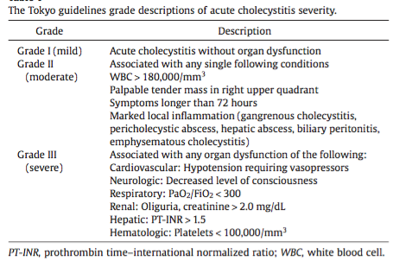
TG18 Severity Grading

Slide 47
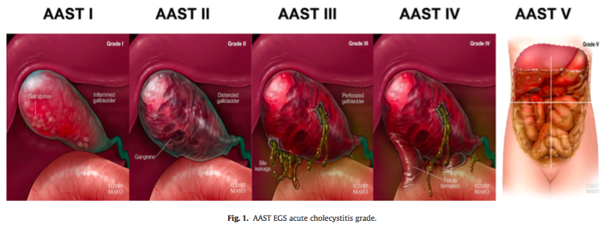
AAST Severity Grading

Slide 48
TG18 Management Based on Severity
Grade I (mild) AC:
LC should ideally be performed soon after onset if the Charlson and ASA-PS scores suggest the patient can withstand surgery.
If patient cannot tolerate surgery, conservative treatment should be performed at first and delayed surgery considered once treatment is seen to take effect
Grade II (moderate) AC
LC should ideally be performed soon after onset if the CCI and ASA-PS scores suggest the patient can tolerate surgery and the patient is in an advanced surgical center
Particular care should be taken to avoid injury during surgery and a switch to open or subtotal cholecystectomy should be considered depending on the findings
If patient cannot withstand surgery, conservative treatment as above and biliary drainage should be considered
Okamoto et al. J Hepatobiliary Pancreat Sci. 2018;25:55–72.

Slide 49
TG18 Management Based on Severity
Grade III (severe) AC
Degree of organ dysfunction should be determined
Attempts to normalize function through organ support, alongside administration of antimicrobials
If patient can withstand surgery, early Lap-C can be performed by a specialist surgeon with extensive experience in a setting that allows for intensive care management
If patient cannot withstand surgery
Conservative treatment
Early biliary drainage should be considered if it is not possible to control the gallbladder inflammation

Slide 50
Controversy Over TG Severity Grading
Hernandez et al. 2018
Compares the AAST vs. TG18 severity grading systems for predicting:
Mortality (AUC 0.86 vs. 0.73)
Complications (AUC 0.76 vs. 0.63)
Need for cholecystectomy tubes (AUC 0.80 vs. 0.68), all p<0.05.
Do not look specifically at BDI, nor do they propose a management algorithm based on the AAST grading or evaluate such a stratification system in reducing risk of complications or BDI

Slide 51
Controversy Over TG Severity Grading
Joseph et al. 2018
Retrospective cohort study
1,982 patients undergoing urgent cholecystectomy
779 had an acute component on final pathology
TG13 missed 35% of gangrenous/acute cholecystitis
Only 39% of patients with an acute component were identified by TG13

Slide 52
PICO 6 - Limitations
The majority of studies demonstrating and increased risk of BDI with AC do not grade the severity of cholecystitis because clinical data are not available
The TG13/18 are currently the only risk stratification model that guides management of patients with acute cholecystitis
In one case-control study, the severity of AC was graded according to the TG13; the risk of injury increased with increasing severity.
The validity of TG18 model in identifying AC is controversial
No evidence that risk stratifying management based on TG18 would have reduced that risk or changed management

Slide 53
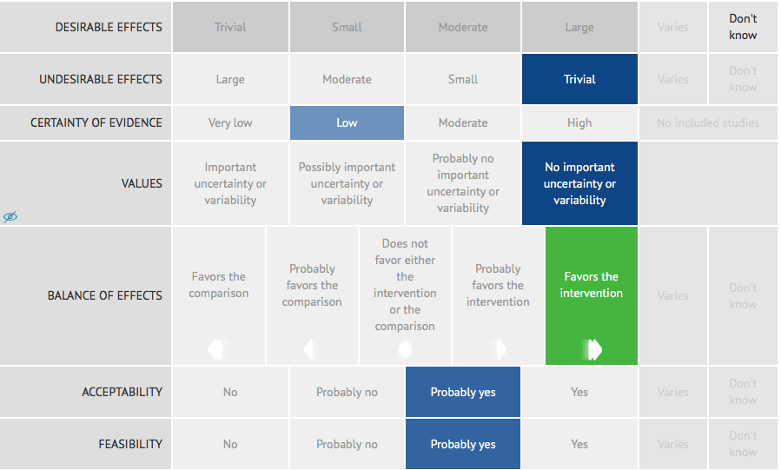
PICO 6 – Summary of Judgments

Slide 54
Recommendation 1
We suggest that surgeons use the Tokyo Guidelines 18 (TG18) for grading and management of patients with acute cholecystitis.
(conditional recommendation, low certainty of evidence)

Slide 55
Vote on PICO 6 A1.
Recommendations

Slide 56
Recommendation 2
During operative planning of laparoscopic cholecystectomy and intraoperative decision-making, we suggest that surgeons consider factors that potentially increase the difficulty of laparoscopic cholecystectomy (such as male gender, increased age, chronic cholecystitis, obesity, liver cirrhosis, adhesions from previous abdominal surgery, emergency cholecystectomy, cystic duct stones, enlarged liver, cancer of gallbladder and/or biliary tract, anatomic variation, biliodigestive fistula, and limited surgical experience).
(conditional recommendation, very low certainty of evidence)

Slide 57
Vote on PICO 6 A2
Recommendations

Slide 58
PICO 7: Question
Should risk stratification that accounts for cholecystolithiasis vs no/alternate risk stratification be used for mitigating the risk of BDI associated with laparoscopic cholecystectomy?
Primary outcome: Bile duct injury

Slide 59
Recommendation
A specific recommendation cannot be provided as no risk prediction models exist that incorporate the presence or absence of gallstones as a factor that increases bile duct injury or difficulty of laparoscopic cholecystectomy.

Slide 60
Future Studies Related to PICO 6 and PICO 7
To be discussed later:
12.B.2 We suggest the development and establishment of valid evidence for a ‘procedure difficulty score’ for laparoscopic cholecystectomy.

Slide 61
PICO 9
Taylor Riall and Dana Telem
Workgroup: Ryan Campagna, Dan Hashimoto, Chris Davis, Marie Crandall, Chantal den Bakker, Leonie van Gastel, Charles Lawrence

Slide 62
PICO 9: Question
Subtotal cholecystectomy compared to total laparoscopic or open cholecystectomy for limiting the risk or severity of bile duct injury in patients who at the time of their operation have MARKED acute LOCAL INFLAMMATION or CHRONIC cholecystitis with biliary inflammatory fusion (BIF) of tissues and tissue contraction?
Primary outcome: Bile duct injury

Slide 63
Recommendation
When marked acute local inflammation or chronic cholecystitis with biliary inflammatory fusion (BIF) of tissues/tissue contraction is encountered during laparoscopic cholecystectomy that prevent the safe identification of the cystic duct and artery, we suggest that surgeons consider subtotal cholecystectomy either laparoscopically or open depending on their skill set and comfort with the procedure (Conditional recommendation, very low level of evidence)

Slide 64
Data: Group Comparison & Primary Outcome
Only 1 article directly compared subgroups (STC vs. LC) with BDI as an outcome metric and directly addressed question 9
University HealthSystem Consortium database, 2009-2013
1:1 propensity score match was used to compare procedural outcomes accounting for clinical and demographic factors
STC (n=487), LC (n=131,082)
Initial analysis STC: longer LOS, higher readmission, higher mortality
After PS matching, NO difference was demonstrated between LC and STC (except cost which was higher for STC)
J Surg Res. 2017 Oct;218:316-321

Slide 65
Data: Group Comparison & Primary Outcome
Concluded: STC Safe and feasible and can be used as an alternative to total LC in select patients.
Limitations:
Confounding variables not accounted for in PS that cannot be derived from administrative database
Clinical heterogeneity (intraoperative details)
Surgeon factors (decision making, skill set, training)
Patient factors (e.g., duration of symptoms, previous attacks)

Slide 66
Data: Addressing STC
The remaining articles:
One article reflected the Tokyo guidelines
11 single group case series (excluded)
2 retrospective comparative cohort studies
1 prospective comparative cohort study
2 systematic reviews.
No cohesive end points are identified for aggregation and comparison.
Groups were not compared.

Slide 67
Retrospective Cohort Study (n=2)
Both single center studies (n=48 and n=3,485) conducted in the Asia Pacific in patients undergoing subtotal cholecystectomy (any approach).
Study 1 was an as-treated and study 2 on an intent to treat basis.
End points not comparable, populations not similar and comparison not made. The single case series had no real comparisons and did not merit inclusion.

Slide 68
Prospective comparative cohort study
Prospective comparative cohort study, n=125,
Compared traditional LC to retroinfundibular approach
Thus the main outcome measure was not compared and groups of interest not compared.

Slide 69
Systematic reviews (n=2)
The first article classified as a systematic review, 91 studies including 324,556 patients were selected for review.
Reviewed 12 studies (n=822) patients for lap subtotal cholecystectomy.
Conversion rate of 0.05%, and concluded with Level 2 evidence that it can be performed safely.
No data on cumulative BDI injury. Did not compare treatment therapies, only commented on variable options. No management consensus determined.

Slide 70
Systematic Reviews: (JAMA Surgery, 2015)
Systematic review: 30 studies, 1,231 patients, 72.9% lap
Follow-up data not reported
Due to AC 72%, cirrhosis 18%, gangrene/perf 6%, Mirizzi 3%
Stump closure: clips, sutures, endoloop, linear stapler
Outcomes for subtotal cholecystectomy
Bile leak 18% (42% fenestrating vs. 16.5% reconstituting)
BDI 0.08%
Retained stones 3.1% (12.0% fenestrating vs. 2.4% reconstituting)
ERCP 4.1%
Reop 1.8%
Elshaer M et al. JAMA Surg 2015;150:159-168.

Slide 71
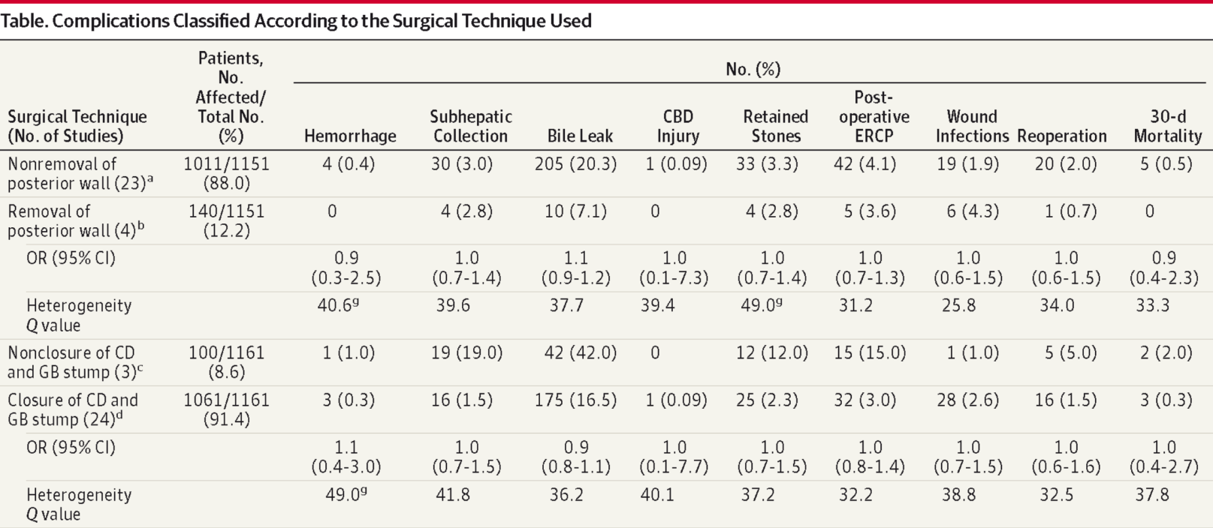
No Difference
No Difference
Elshaer M et al. JAMA Surg 2015;150:159-168.

Slide 72
Meta-analysis continued
Only comparison was laparoscopic versus open
Laparoscopic approach (vs open) produced less risk of:
Subhepatic collection (odds ratio [OR], 0.4; 95% CI, 0.2-0.9)
Retained stones (OR, 0.5; 95% CI, 0.3-0.9)
Wound infection (OR, 0.07; 95% CI, 0.04-0.2)
Reoperation (OR, 0.5; 95% CI, 0.3-0.9)
Mortality (OR, 0.2; 95% CI, 0.05-0.9)
Lap (vs. open) was associated with increased risk of bile leaks (OR, 5.3; 95% CI, 3.9-7.2)
Elshaer M et al. JAMA Surg 2015;150:159-168.

Slide 73
Limitations Driving Recommendation
Lack of comparative effectiveness research
Heterogeneity precluding comparison in current studies
Patient factors (e.g., clinical presentation, relevant history)
Clinical factors (e.g. intraoperative findings, preoperative workup)
Surgeon factors (e.g., training, skill set, judgement)
Technical factors (e.g., how STC performed, defined)
Low incidence of BDI

Slide 74
Future Directions
Comparative effectiveness research to ascertain/specify when and in whom STC is appropriate as compared to open or lap total cholecystectomy
Education of surgeons in technique to ensure proper performance.

Slide 75
Recommendation
When marked acute local inflammation or chronic cholecystitis with biliary inflammatory fusion (BIF) of tissues/tissue contraction is encountered during laparoscopic cholecystectomy that prevent the safe identification of the cystic duct and artery, we suggest that surgeons consider subtotal cholecystectomy either laparoscopically or open depending on their skill set and comfort with the procedure (Conditional recommendation, very low level of evidence)

Slide 76
Vote on PICO 9 Recommendation

