Slide 1

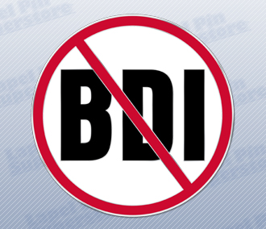
Multi-society State-of-the-Art Consensus Conference on Prevention of Bile Duct Injury During Cholecystectomy
Sponsored by:
SAGES
AHPBA
IHPBA
SSAT
EAES

Slide 2
Work Group Five
PICO #15-17
Group Leads
  Rajesh Aggarwal, MD PhD FACS FRCS, Thomas Jefferson University
  Carol-Anne Moulton, MBBS PhD FRACS, University of Toronto
Group Members
  Philip Pucher, MD PhD MRCS, Imperial College London
  Sara Monafred, MD, University of Indiana
  Nathan Stoikes, MD, University of Tennessee Health Science Centre
  Byron Fernando-Santos, MD, Dartmouth-Hitchcock Medical Center
  Ryan Campagna, MD, Northwestern University
  Romeo Ignacio, MD, Naval Medical Center San Diego

Slide 3
PICO #15
PICO 15: Should CVS coaching of surgeon vs no coaching be used for mitigating the risk of BDI associated with laparoscopic cholecystectomy?
Primary Outcome – BDI
Secondary Outcome – CVS Quality

Slide 4

PICO #15

Slide 5
PICO #15

Slide 6
PICO #15
Recommendation A
  We suggest continued education of surgeons regarding the critical view of safety during laparoscopic cholecystectomy that may include coaching. (Conditional recommendation, very low certainty of evidence)
References
  Nijssen MA, Schreinemakers JM, van der Schelling GP, Crolla RM, Rijken AM. Improving Critical View of Safety in Laparoscopic Cholecystectomy by Teaching Interventions. J Surg Educ. 2016 May-Jun;73(3):442-7.
  Stefanidis D, Chintalapudi N, Anderson-Montoya B, Oommen B, Tobben D, Pimentel M. How often do surgeons obtain the critical view of safety during laparoscopic cholecystectomy? Surg Endosc. 2017 Jan;31(1):142-146.
  Sanford DE, Strasberg SM. A simple effective method for generation of a permanent record of the Critical View of Safety during laparoscopic cholecystectomy by intraoperative "doublet" photography. J Am Coll Surg. 2014 Feb;218(2):170-8.

Slide 7
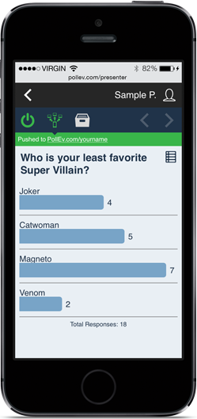
Vote on PICO 15 Recommendation

Slide 8
PICO #16
PICO 16: Should training by simulation or video-based education vs alternative surgeon training be used for mitigating the risk of BDI associated with laparoscopic cholecystectomy?
Primary Outcome – BDI

Slide 9
PICO #16

Slide 10
PICO #16
Current evidence is insufficient to determine the benefit of simulation vs video-based vs alternative surgeon training modalities on limiting/avoiding bile duct injury.
Recommendations for future study/ type B:
  We suggest the conduct of prospective large-scale multi-center studies to determine the role of simulation vs video-based vs alternative surgeon training modalities on limiting/avoiding bile duct injury.

Slide 11
Vote on PICO 16B Recommendation

Slide 12
PICO #17
PICO 17: Should more vs less surgeon experience be used for mitigating the risk of BDI associated with laparoscopic cholecystectomy?
Primary Outcome – BDI
Secondary Outcomes – Mortality, Morbidity, Conversion

Slide 13
PICO #17

Slide 14
PICO #17

Slide 15
PICO #17

Slide 16
PICO #17
Recommendation A:
  We suggest that surgeons have a low threshold for calling for help from another surgeon when practical in difficult cases or when there is uncertain of anatomy (conditional recommendation, low certainty of evidence).
References
  Flum DR, Koepsell T, Heagerty P, et al. Common bile duct injury during laparoscopic cholecystectomy and the use of intraoperative cholangiography: adverse outcome or preventable error? Arch Surg. 2001 Nov;136(11):1287-92.
  Schwaitzberg SD, Scott DJ, Jones DB, McKinley SK, Castrillion J, Hunter TD, Brunt LM. Threefold increased bile duct injury rate is associated with less experience in an insurance claims database. Surg Endosc. 2014. 28:3068-3073.
  Koulas SG. Tsimoyiannis J, Koutsourelakis I, et al. Laparoscopic cholecystectomy performed by surgical trainees. JSLS. 2006 Oct-Dec;10(4):484-7.

Slide 17
Vote on PICO 17A Recommendation

Slide 18
PICO #17
Recommendation for future studies/Type B Recommendation:
  We suggest the conduct of prospective research studies to develop evidence-based guidelines for physicians who are in transition in practice/from residency/fellowship to independent practice, in order to mitigate the risk of BDI associated with laparoscopic cholecystectomy.
References
  Flum DR, Koepsell T, Heagerty P, et al. Common bile duct injury during laparoscopic cholecystectomy and the use of intraoperative cholangiography: adverse outcome or preventable error? Arch Surg. 2001 Nov;136(11):1287-92.
  Schwaitzberg SD, Scott DJ, Jones DB, McKinley SK, Castrillion J, Hunter TD, Brunt LM. Threefold increased bile duct injury rate is associated with less experience in an insurance claims database. Surg Endosc. 2014. 28:3068-3073.
  Koulas SG. Tsimoyiannis J, Koutsourelakis I, et al. Laparoscopic cholecystectomy performed by surgical trainees. JSLS. 2006 Oct-Dec;10(4):484-7.

Slide 19
Vote on PICO 17B Recommendation

Slide 20
Recommendation 19
Additional Panel Recommendation: Type B Recommendation
19. We suggest the development of national quality improvement initiatives for the prevention of bile duct injuries following cholecystectomy. The initiatives(s) should be capable of identifying and characterizing bile duct injuries in the population under study.

Slide 21
Vote on PICO 19 Recommendation

