Slide 1
Multi-society State-of-the-Art Consensus Conference on Prevention of Bile Duct Injury During Cholecystectomy
Sponsored by:
SAGES
AHPBA
IHPBA
SSAT
EAES

Slide 2
L. Michael Brunt, MD Disclosures:
Institutional research support: Gore
Chair, SAGES Safe Cholecystectomy Task Force

Slide 3
JAMA 1993; 269: 1018-1024

Slide 5
Conference Background/Goals
To identify optimal strategies for BDI prevention during cholecystectomy.
To develop and disseminate evidence-based practice guidelines for safe cholecystectomy.
The information from this conference should help inform efforts by surgical training programs, hospitals, and professional associations to create and disseminate interventions that enhance patient safety in cholecystectomy and improve patient outcomes.

Slide 6
Consensus Conference Timeline
2014 SAGES Safe Cholecystectomy Task Force formed
2016 joint session (SAGES, AHPBA, IHPBA) on safety in cholecystectomy at 13th International HPB Association Meeting, Sao Paulo, Brazil
Multi-society Task Force and Steering Committee formed 2016
Process for consensus meeting
Development of key questions for conference
Formulation of work groups/leads
Literature search and data extraction
GRADE evidence development and formulation of recommendations
Voting by group leads on consensus recommendations
Oct 20 consensus meeting and presentation of recommendations and voting by panel of experts

Slide 7
Consensus Conference Steering Committee
Society | Representative
SAGES | Michael Brunt, Horacio Asbun
AHPBA | Rebecca Minter, Charles Vollmer
IHPBA | Oscar Imventarza
SSAT | Nat Soper
EAES | Jaap Bonjer

Slide 8
Consensus Work Groups
Work Groups | PICO Questions | Leads | Members
1 | 1,2,3 | Daniel Deziel, Marian McDonald | Maria Altieri, Ben Veenstra, Justin Gerard, Ismael Domiguez-Rosado, MacKenzie Landin
2 | 4,5 | Michael Brunt, Adnan Alseidi, Mike Ujiki | Tim Schaffner, Eugene Ceppa, Sadiq Sikora, Sara Holden, Shanley Deal, Alessandro Paganini, Bailey Su
3 | 6,7,9 | Dana Telem, Taylor Riall | Daniel Hashimoto, Chris Davis, Marie Crandall, Ryan Campagna, Chantal den Bakker, Leonie van Gastel, Charles Lawrence
4 | 8,11 | Steven Strasberg, Saxon Connor, Chet Hammill | Blaire Anderson, Megan Thomas, Scott Dojels, Waala Abdelmoaty
5 | 10, 12-17 | Raj Aggarwal, Carol-Anne Moulton | Phil Pucher, Fernando Santos, Nate Stoikes, Romeo Ignacio, Ryan Campagna, Sara Monafred
6 | 18 | Horacio Asbun, Rowan Parks, Jaap Bonjer | Ewen Harrison, Luigi Boni, Oscar Imventarza, Rohan Jeyarajah, Marc Mesleh, Domenech Asbun, Levan Tsalamaidze, Eline Zwart

Slide 9
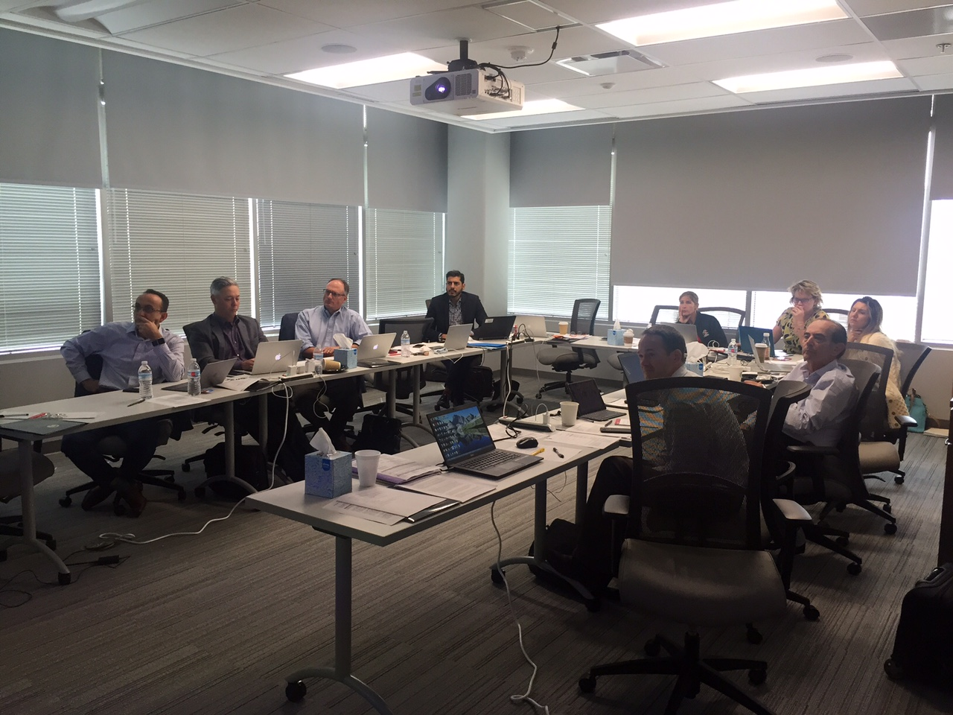
Conference Planning:

Slide 10
Expert Voting Panel
Society Representation:
Experts Panelists
AHPBA: Chuck Vollmer, Keith Lillemoe, Attila Nakeeb, Wright Pinson, Emily Winslow, Major Kenneth Lee
SSAT: Nat Soper, Henry Pitt, Jeff Barkun, Mark Callery
IHPBA: Oscar Imventarza, Miguel Mercado
SAGES: Steve Schwaitzberg, Ken Murayama, Gary Vitale, Kevin Wasco
EAES: Andrea Pietrabissa, Abe Fingerhut
AAST: Jose Diaz, Stephen Barnes
Rural/Community surgeons: Randy Zuckerman, Patrick Molt, Tyler Hughes
ELSA: Alfred Buenafe, Davide Lomanto
At Large: Go Wakabayashi
Americas Hepato-Pancreato-Biliary Association
European Association of Endoscopic Surgeons
International HPB Association
Society for Surgery of the Alimentary Tract
Society American Gastrointestinal and Endoscopic Surgeons
American Association for the Surgery of Trauma
Rural/Community surgeons group
Endoscopic and Laparoscopic Society of Asia

Slide 11
Acknowledgements
Dimitrios Stefanidis, MD, PhD– Chair SAGES Guideline Committee
Stephen Haggerty, MD, Co-Chair, SAGES Guideline Committee
Mohammed Ansari, MD, MMedSci, MPhil – Research Methodologist, Univ Ottawa
Valerie Langberg, Sc.M - Biostatistician, Brown University
Brenda Castaneda – SAGES Staff
Shelley Ginsburg – SAGES Staff

Slide 12
Conference Grant Support
National Institutes of Diabetes and Digestive and Kidney Diseases: This conference is supported by an R13 conference grant NIDDK 1 R13 DK 120271-01. The views expressed in written conference materials or publications and by speakers and moderators do not necessarily reflect the official policies and of the Department of Health and Human Services; nor does mention by trade names, commercial practices, or organizations imply endorsement by the US government.
SAGES Education and Research Foundation

Slide 13
We gratefully acknowledge educational grant support for this conference from the following:
Boston Scientific
Ethicon, Inc
Intuitive Surgical
Karl Storz Endoscopy
Medtronic
Stryker Endoscopy

Slide 14
Consensus Schedule:
8:00-9:00 Introductory session
9:00-10:00am PICOs 1-3
10:00-10:15am Break
10:15-12:15 PICOs 4-7, 9
12:10-1:00pm Buffet Lunch
1:00-1:50pm PICOs 8,11
1:50-3:00pm PICOs 10, 12-14, 18
3:00-3:15pm Break
3:15-4:00pm PICOs 15-17
4:00-4:30pm Open Panel Discussion
4:30-4:40pm Closing Remarks

Slide 15
#PreventBDI
Help Us Share Live Updates from
the Conference!
Use this hashtag on your
social media sites during the meeting.

Slide 17
Multi-society State-of-the-Art Consensus Conference on Prevention of Bile Duct Injury During Cholecystectomy
Sponsored by:
SAGES
AHPBA
IHPBA
SSAT
EAES

Slide 18
Impact of Bile Duct Injury on the Patient and Society
Dana A. Telem MD MPH
Associate Professor of Surgery
Associate Chair for Clinical Affairs
Director, Comprehensive Hernia Program
University of Michigan
Tweet: #PreventBDI

Slide 19
Disclosures
Agency for Healthcare Research and Quality (AHRQ) KHS025778A
Medtronic
** None relevant to the subject matter of this talk

Slide 20
Cholecystectomy (LC)
~750,000 laparoscopic cholecystectomies/year
Complications occur in up to 6-7% of patients*
Bleeding
Abscess
Bile leak
Bowel/vascular injury
Wound complications
Common bile duct injury (BDI)
Impact on health resource utilization – perioperative ER utilization 10%, readmission 5-7%
Murphy et al. JACS 2010;21:73-80

Slide 21
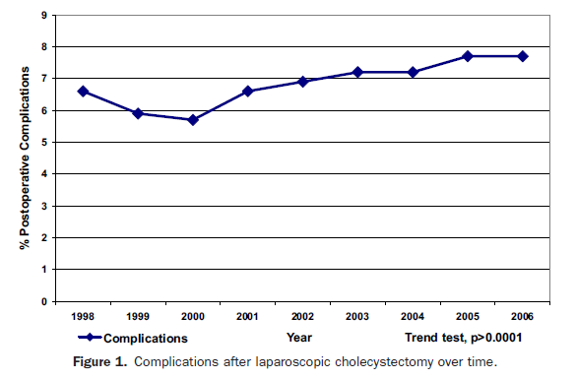
Complications of LC over time
7.7%
6.6%
Trends in complications of LC over time (NIS)
Data until 2006 – still relevant
Murphy et al. JACS 2010;21:73-80

Slide 22
BDI
BDI is the most dreaded complication
Incidence is variable
Depends on whether inclusive of bile leaks
Up to 4 per 1000
Data indicating incidence may be decreasing
NY State (2005-2010): Major BDI 0.08%
Buenos Aires (1991-2010): Major BDI 0.2%
Surg Endosc. 2016
J Am Coll Surg. 2013;216(5):894-901

Slide 23
BDI: Contemporary Studies
Study | Source | N | Total BDI
Schwaitzberg 2014 | Payor admin data | 53,632 | 82 (0.15%)
Tornqvist 2015 | Swedish national registry | 51,041 | 747 (1.5%; 0.36% major BDI)
Barrett 2017 | Truven database | 319,184 | 741 (0.23%) major BDI
Lilley 2017 | Medicare Admin data | 472,367 | 0.3%
Pucher 2018 | Systematic review | 505,292 | 0.32-0.52%
Fong 2018 | CA State Admin data | 711,454 | 0.22% major BDI 0.50% bile leaks

Slide 24
BDI
Data derived from GallRiks.
Founded in 2005
National Swedish Registry for Surgery and ERCP
Captures ~90 per cent of all cholecystectomies
Aims to provide current information regarding indications, treatment methods and complications.
1.5% of patients had BDI (including bile leaks)
Incidence of major BDI requiring reconstruction was 0.4%
Br J Surg. 2015;102(8):952-8
Arch Surg. 2006;141(12):1207-13.

Slide 25
Distribution of BDI
Distribution of 747 bile duct injuries among 51,041 cholecystectomies in GallRiks (2005-10)
Type of Injury (n=747) | Hannover Grade | N (%)
Cystic duct leak | A1 | 265 (35.5)
Peripheral duct injury gallbladder bed | A2 | 106 (14.2)
Tangential lesion common bile duct | C1, C2, C3 | 130 (17.4)
Transected bile duct (below hepatic bifurcation) | D1, D2, D3 | 16 (2.1)
Obstructive injuries | B1, B2 | 7 (0.9)
Lesions above the hepatic bifurcation | C4, D4 | 32 (4.3)
Injuries with insufficient information |  | 191 (25.6)
Br J Surg. 2015;102(8):952-8

Slide 26
Self-reported Incidence of BDI
Survey administered to practicing surgeons across US (2001)
Anonymous questionnaire mailed to 3,657 who completed an ACGME accredited residency.
45% (n=1,661) completed and returned the survey
565 self–reported bile duct injuries
** 34% of surgeons self-reported a BDI **
Ann Surg. 2001;234(4):549-58.

Slide 27
Societal Impact OF BDI
Significant economic healthcare burden
ONE BILLION in associated health care costs
A key source of medical malpractice claims against surgeons
BDI malpractice claims represent 20% of money paid to plaintiffs
Surg Endosc 2013;27:1051-1054; HPB. 2009;11(2):130-4

Slide 28
Impact on Patients: Clinical
Numerous reinterventions/hospitalizations
Early/late complications
Mortality (short-term)
Mortality (long-term) – 20.8%
8.8% above the cohort’s expected age-adjusted rate of death
Surg Endosc. 2016

Slide 29
Long term Mortality
N=800
Mean Survival: 17.6 years
BDI related mortality: 3.5%
Booij K, Ann Surg. 2018

Slide 30
Quality of Life (QOL)
Evaluation of QOL after surgical repair of major bile duct injuries (n=89).
Significant difference as evaluated from a psychological dimension.
Physical and social domains comparable to control patients.
Presence of a lawsuit was associated with a poorer QOL assessment
Ann Surg. 2002 Jun;235(6):888-95

Slide 31
Quality of Life (QOL)
N=62 BDI
Statistically similar:
Physical functioning
Bodily pain
General health perceptions
Vitality and social functioning
Mental health index
Mean emotional scores were worse
Ann Surg. 2009 Feb;249(2):292-5

Slide 32
Quality of Life (QOL) – Long Term
Longitudinal QOL study (n=403, response 68%)
Changes in outcome at a mean of 5.5 and 11 yrs
At 5-years, QOL significantly worse as compared to chole and non-operative controls
No improvement at 11 years
19% filed a malpractice claim
QOL improved if claim resolved in their favor vs. if claim rejected
Endoscopy. 2008 Aug;40(8):637-43.

Slide 33
Quality of Life (QOL) – Long Term
Long-term study of 800 BDI pts (compared to 175 controls) in Amsterdam
Patients with BDI
Significantly worse physical QoL
Significantly worse disease specific QoL
Increased loss of work productivity
Increase rate of receiving daily benefits
Booij K, Ann Surg. 2018

Slide 34
Quality of Life (QOL) – Long Term
Booij K, Ann Surg. 2018

Slide 35
Patient Accounts
http://www.curezone.org/forums/am.asp?i=1501569

Slide 36
Take Home
Major BDI injury rate still in 0.4% range
Translates to 3000 injuries/year in US
>$1 billion in associated costs
½ medicolegal ½ patient care
Key contributor to healthcare costs and adverse patient and surgeon outcomes

Slide 37
Thank you! Questions?
@DanaTelem

Slide 38
Multi-society State-of-the-Art Consensus Conference on Prevention of Bile Duct Injury During Cholecystectomy
Sponsored by:
SAGES
AHPBA
IHPBA
SSAT
EAES

Slide 39
Steven M. Strasberg, M.D. Section of Hepatobiliary and Pancreatic Surgery
Introduction to The PICO Questions

Slide 40
3 Topics in 10 Minutes
Definition: Major/Minor Bile duct Injury
Incidence of BDI and Effect on Studies of BDI
The PICO Questions

Slide 41
HPB 2018, 20: 370–378
Surgery
Cho
Chapman
deSantibanes
Domingues
Garden
Gouma
Lillemoe
Mercado
Padbury
Pitt
Tornqvist
Strasberg
Biliary Endoscopy
Baron
Carr-Locke
Costamagna
Mullady
Sherman
Interventional Radiology
Picus
Schlansky- Goldberg

Slide 42
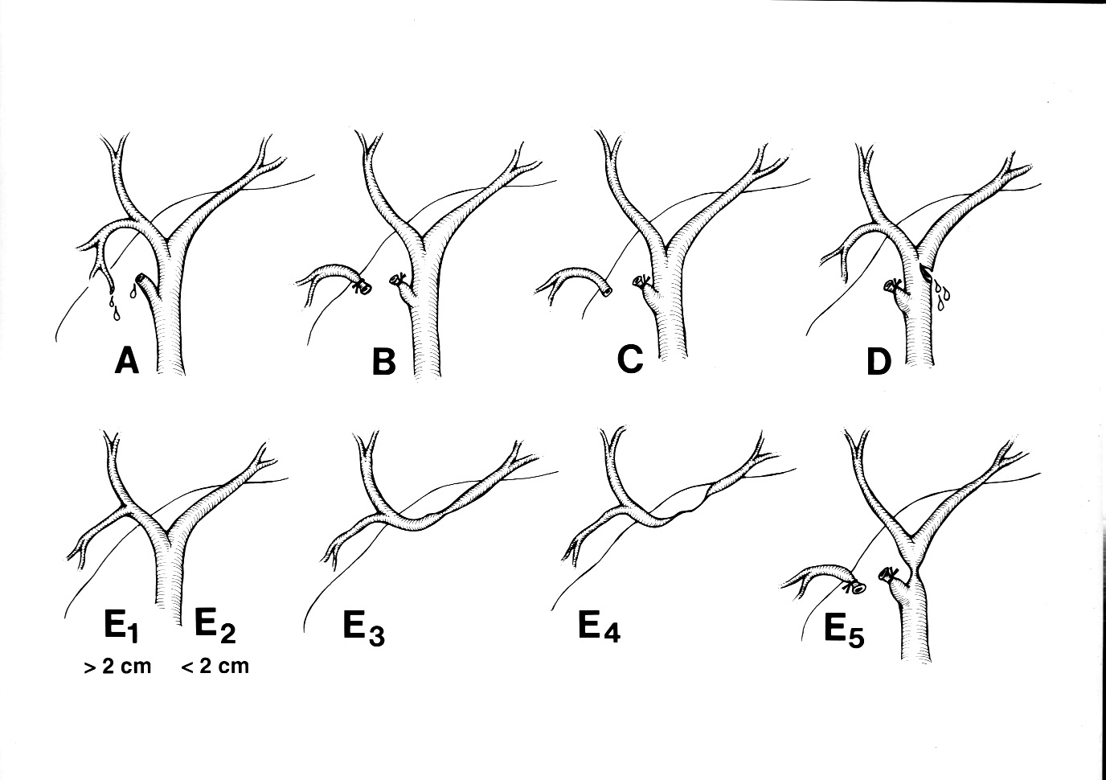
Washington University Classification of Biliary Injuries

Slide 43
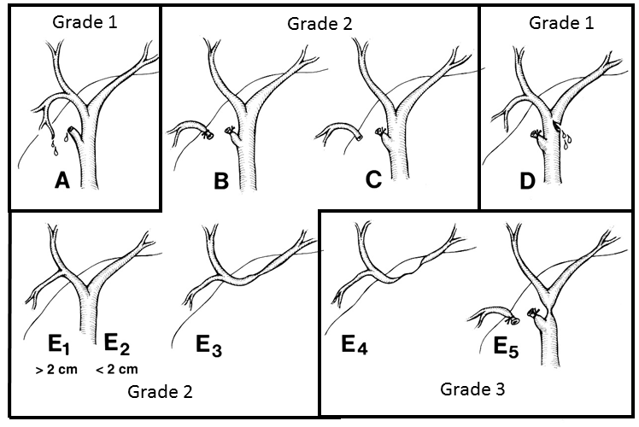
International Severity Grading of Biliary Injury
Grade 1: Stent or Suture
Grade 2: One duct for anastomosis or stenting
Grade 3: More than one duct for anastomosis or stenting

Slide 44
International Severity Grading of Biliary Injury
Major Bile Duct Injuries
Grade 2: One duct for anastomosis or stenting
Grade 3: More than one duct for anastomosis or stenting
MAJOR = Grade 2 and Grade 3

Slide 45
Incidence of BDI and Studies of BDI
Major BDI in open era 1 in 1000
Major BDI in lap era 3 in 1000
1 million LC /yr = 3000 major BDIs in the USA
Major BDIs have aspects of rare and common problems,
To have sufficient events for studies thousands of patients are needed.
Drawing conclusions from fewer patients may give an illusion of safety “500 LCs with only 1 BDI”
Probably need at least 5000-10,000 in comparative study
Studies of BDIs themselves are probably rewarding
20 BDIs happen in 6000 patients

Slide 46
Types of Studies on BDI
Observational studies of patients with bile duct injuries
Single or Multicenter Studies of Laparoscopic Cholecystectomy including RCTs and MAs
Population Studies of Laparoscopic Cholecystectomies
10-500 patients. Small number of patients but large number of events
100-2000 patients. Larger number of patients but relatively few events
3000-50,000+ patients. Largest number of patients with large number of events

Slide 47
Theoretical Study of BDI in Open vs Lap Chole with 2000 Patients
Open Chole
1000 patients
Lap Chole
1000 patients

Slide 48
Theoretical Study of Open vs Lap Chole with 2000 Patients
Open Chole
1000 patients
Projected BDI rate 0.1%
Events?
Lap Chole
1000 patients
Projected BDI rate 0.3%
Events?

Slide 49
Theoretical Study of Open vs Lap Chole with 2000 Patients
Open Chole
1000 patients
Projected BDI rate 0.1%
Events = 1
Lap Chole
1000 patients
Projected BDI rate 0.3%
Events = 3

Slide 50
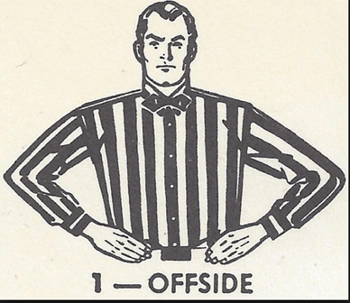
Theoretical Study of Open vs Lap Chole with 2000 Patients
Open Chole
1000 patients
Projected BDI rate 0.1%
Events = 1
Lap Chole
1000 patients
Projected BDI rate 0.3%
Events = 3
4 events in 2000 patients.
Too few BDIs to draw conclusions
Underpowered fault

Slide 51
Types of Studies on BDI
Observational studies of patients with bile duct injuries
Single or Multicenter Studies of Laparoscopic Cholecystectomy X including RCTs and MAs
Population Studies of Laparoscopic Cholecystectomies
10-500 patients. Small number of patients but large number of events
100-2000 patients. Larger number of patients but relatively few events
3000-50,000+ patients. Largest number of patients with large number of events

Slide 52
The Questions

Slide 53
Prevention of Bile Duct Injury Consensus Conference Questions Draft October 30, 2016
The SAGES Prevention of Bile Duct Injury Consensus Conference work group has identified the following 10 questions that should be considered for the consensus conference
What is the incidence of bile duct injury (BDI) during cholecystectomy and how should these injuries be classified?
What is the incidence of major BDI?
What are the types of BDI (nature and classification)?
2.What is the impact of bile duct injuries on patient outcomes and associated health care costs?
What is the effect of BDI on the quality of life and longevity of the patient?
What are the costs to the health care system associated with BDI?
What are the medical-legal implications of BDI and what are the primary factors that impact outcomes of litigation?

Slide 54
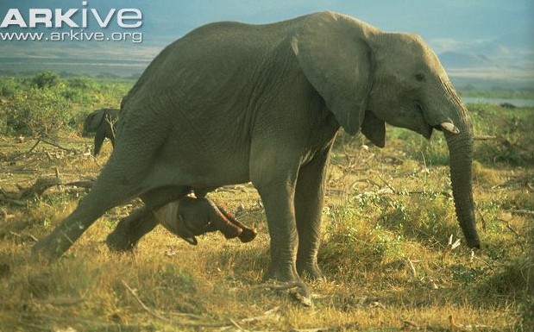
Mother elephant delivering a baby elephant - Period of gestation twenty-two months

Slide 55
Prevention of Bile Duct Injury Consensus Conference
Decision to concentrate on Guideline Development
Use of GRADE method of guideline development

Slide 58
PICO Format Questions

Slide 59
PICO formatting frames the question
P=population
I=intervention
C=comparator
O=outcome(s)

Slide 60
PICO Question 8
P
I
C
O 8
In patients with acute cholecystitis how effective is
early cholecystectomy versus delayed cholecystectomy
in limiting the risk and severity of bile duct injury?

Slide 61
Condensed PICO Question List: State of the Art Consensus Conference on Prevention of Bile Duct Injury*
Should one anatomic technique (CVS) vs another (infundibular, top down, IOC) be used to reduce or limit risk of BDI during cholecystectomy (CCX)?
Should the top down technique vs subtotal cholecystectomy be used when the CVS cannot be achieved?
How should the CVS be documented during laparoscopic cholecystectomy (still doublet photos vs operative notes vs video vs no documentation)?
Should intraoperative biliary imaging (e.g. intraoperative cholangiography, US) vs no intraoperative biliary imaging be used for limiting the risk of bile duct injury during laparoscopic cholecystectomy?
Should near infrared vs IOC or white light be used in avoiding /limiting BDI?
Should surgical (complexity) risk stratification vs alternative or no risk stratification be used for limiting/preventing BDI?
Should risk stratification that accounts for cholecystolithiasis vs no/alternate risk stratification be used for limiting/preventing BDI?
Should immediate cholecystectomy (within 72 hrs from symptom onset) vs CCX delayed beyond 72 hours (< 6 weeks vs >6-12 weeks) be used for acute cholecystitis?
Should subtotal CCX vs total laparoscopic or open CCX be used for limiting/avoiding BDI in marked acute inflammation or chronic biliary inflammatory fusion (BIF)?
Should 4-port lap cholecystectomy vs reduced port/single incision vs robotic CCX be used for limiting/avoiding BDI?
Should interval/delayed lap chole vs no additional treatment be used for patients previously treated by percutaneous cholecystostomy?
Should conversion of laparoscopic to open cholecystectomy vs no conversion be used for limiting/avoiding BDI in the difficult laparoscopic cholecystectomy?
Should a time out to verify the CVS vs no time out be used for limiting/avoiding BDI?
Should two vs one surgeon(s) be used for limiting/avoiding BDI?
Should CVS coaching of surgeon vs no coaching be used for limiting/avoiding BDI?
Should training by simulation or video-based education vs alternative surgeon training be used for limiting/avoiding BDI?
Should more vs less surgeon experience be used for limiting/avoiding the risk of BDI?
Should immediate reconstruction by the operating surgeon vs referral to a specialty center be used for patients with BDI during cholecystectomy?

Slide 62
18 PICO Questions: Focussed Mainly on Prevention of Bile Duct Injury
PICO 1-5: Anatomic identification in CCX
PICO 6-8: Role of disease and patient factors
PICO 9-12: Place of surgical techniques other than laparoscopic total cholecystectomy
PICO 13-17: Role of the surgeon and education of the surgeon
PICO 18: Management of bile duct injury

Slide 63
18 PICO Questions Focussed Mainly on Prevention of Bile Duct Injury
It was expected that much data would be available for some question while little data would be available for others.
Therefore some data rich questions will result in recommendations coming directly from the GRADE review (when to operate in AC) while other data poor ones will act as stimuli and pathways for studies which experts consider most important for future development the field of biliary injury prevention (does coaching/simulation reduce BDI)

Slide 64
Recommendations PICO 8: Can be Type A or B
Type A recommendations flow from the data in the GRADE process. Currently available evidence supports the recommendations.
Type B recommendations flow from recognition of deficiencies in our knowledge which were also identified during the GRADE review and these recommendations relate to studies to be done or study methodology in the future.

Slide 65
Steven M. Strasberg, M.D. Section of Hepatobiliary and Pancreatic Surgery
The PICO Questions

Slide 66
Multi-society State-of-the-Art Consensus Conference on Prevention of Bile Duct Injury During Cholecystectomy
Sponsored by:
SAGES
AHPBA
IHPBA
SSAT
EAES

Slide 67
Formulating and Answering a Guideline Question
Mohammed T. Ansari (MD, MMedSc, MPhil)
Consultant Guideline Methodologist
Adjunct Professor, University of Ottawa
Scientific Evaluator, Health Canada

Slide 68
Disclosure of Conflicts of Interest
Financial – none
Intellectual – none

Slide 69
The GRADE Approach
GRADE: The Grading of Recommendations Assessment, Development and Evaluation
Methods approach developed collaboratively by many international organizations
Adopted by more than 100 organizations (e.g. the World Health Organization, the UK National Institute for Health and Care Excellence, etc)
Now considered the standard in guideline development

Slide 70
Guideline Question
A Guideline question addresses variability and uncertainty in clinical practice
The question may be about etiology, therapy, diagnosis, or prognosis
Guideline questions are phrased in a language that reflects the relevant decision-making equipoise
The usual presentation of the Q is:
Should option A vs. option B be used for a condition, a state of health, health purpose, or population

Slide 71
Question Specific PICO
Population, intervention, comparator and outcome(s)
Potential challenges:
how broadly the patients and intervention should be defined (mild or severe disease, low or higher dose, class effect or specific drugs?)
multiple comparators (no treatment, alternative therapy or therapies)
specification of patient-oriented outcomes (usually: morbid and mortal events, hospitalization, QOL, disability, inconvenience, resource use, and unintended harms)

Slide 72
Outcome Prioritization
Categories: critical, important, and limited importance on a 1-9 scale
Importance varies by perspective – for CPGs, the perspective would generally be that of the patient
Evidence of patient values and preferences and associated variability should be sought
3 Steps – preliminary classification, reassessment in light of evidence, and judging the balance between the desirable and undesirable effects

Slide 73
Outcome Proxies (contingency!)
Surrogate outcome must be in the causal pathway of the disease process.
Surrogate end point must capture the net effect of the treatment on the patient-important outcome.
Examples – narcotic consumption for postop pain, Hb for blood loss, CVS for BDI…..

Slide 74
Example Q: Should fewer than four ports vs. four ports be used for laparoscopic cholecystectomy?
Population – patients undergoing laparoscopic cholecystectomy (elective or emergency) for any reason
Intervention – Single-port, single-incision LCCX
Comparator – Standard four-port LCCX
Outcomes – BDI, readmission, total analgesic consumption, total serious or major complications, duration of surgery, and failure to complete cholecystectomy
Proxy outcomes: CVS, conversion, intraoperative blood loss

Slide 75
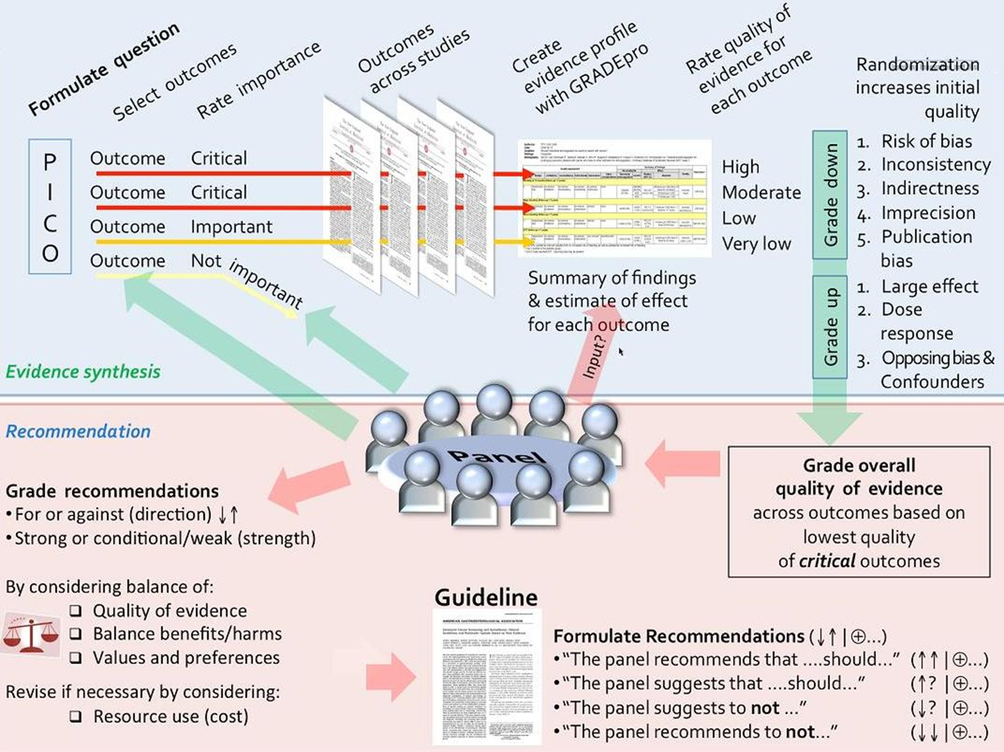

Slide 76
Introduction to GRADE Approach for Rating Certainty of Evidence

Slide 77
Grading Certainty of Evidence
Definition of CoE: the extent of our confidence that the estimates of the effect are correct or are adequate to support a particular decision or recommendation
Outcome specific
Applies to the Body of contributing evidence (a meta-analysis or a narrative synthesis)
Rated as High, moderate, low or very low

Slide 78
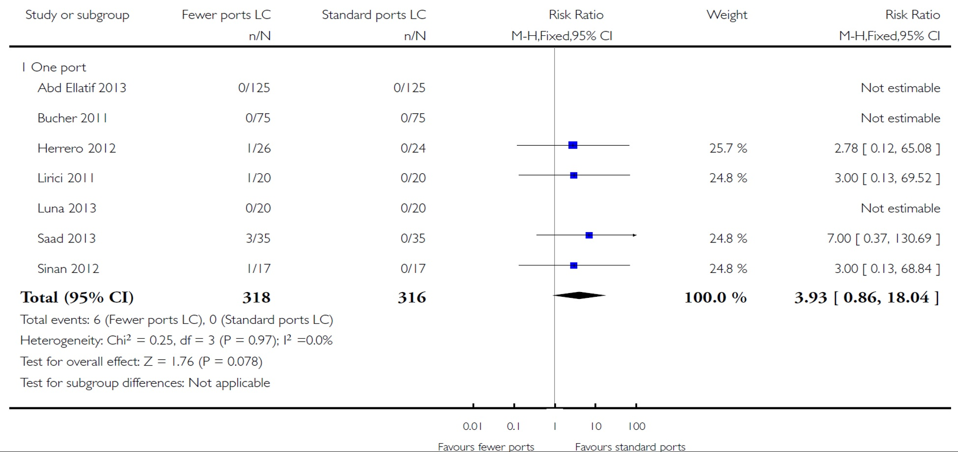
Fewer-than-four ports versus four ports for laparoscopic cholecystectomy: serious adverse events, CDSR 2014

Slide 79
Example of an Evidence Profile (< 4 ports vs. 4 ports for Lap Chole)
Certainty assessment |  |  |  |  |  |  | № of patients |  | Effect |  | Certainty
№ of studies | Study design | Risk of bias | Inconsistency | Indirectness | Imprecision | Other considerations | fewer than four ports | four ports | Relative (95% CI) | Absolute (95% CI)
SERIOUS ADVERSE EVENTS
7 | randomised trials | very serious | not serious | not serious | very serious | none | 6/318 (1.9%) | 0.0% | RR 3.93 (0.86 to 18.04) | 1 more per 1,000 (from 0 fewer to 5 more) | ⨁◯◯◯ VERY LOW
CONVERSION TO OPEN CHOLECYSTECTOMY
5 | randomised trials | very serious | not serious | not serious | very serious | none | 3/289 (1.0%) | 5/292 (1.7%) | RR 0.68 (0.19 to 2.35) | 5 fewer per 1,000 (from 14 fewer to 23 more) | ⨁◯◯◯ VERY LOW

Slide 80
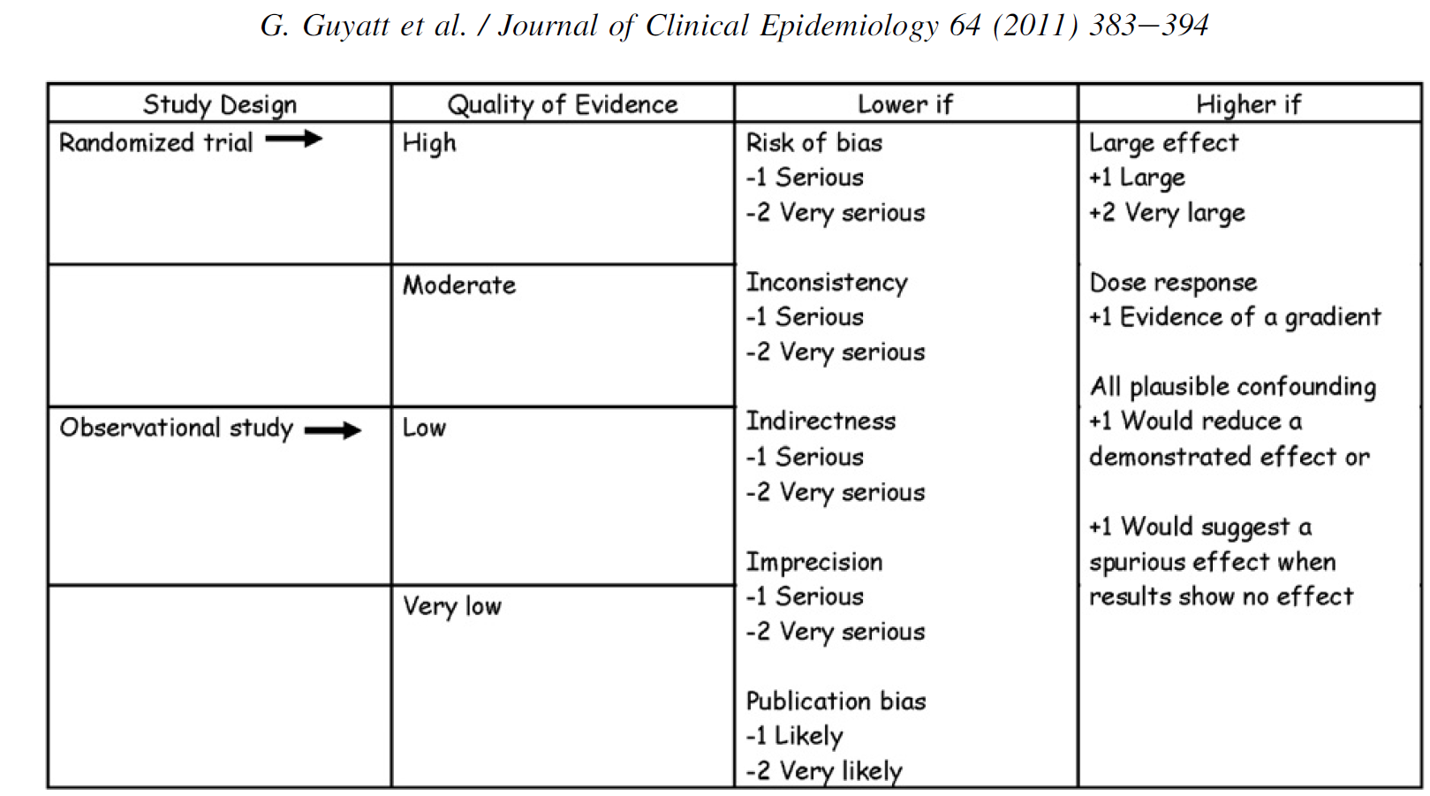
Quality of Evidence Domains

Slide 81
THANK YOU!
………………………………………….Questions?

Slide 82
Multi-society State-of-the-Art Consensus Conference on Prevention of Bile Duct Injury During Cholecystectomy
Sponsored by:
SAGES
AHPBA
IHPBA
SSAT
EAES

Slide 83
SAGES Guideline Development Process
Dimitrios Stefanidis, MD, PhD
Chair, SAGES guidelines committee
Vice Chair of Education
Chief, MIS/ Bariatric Surgery
Indiana University School of Medicine

Slide 84
Disclosures
Nothing to disclose

Slide 85
Evidence-based Medicine (EBM)
Evidence based medicine is the conscientious, explicit, and judicious use of current best evidence in making decisions about the care of individual patients
Clinician training
and experience
Judicious
integration
of science
Patient
preferences
and values

Slide 86
Guidelines
Systematically developed statements to assist practitioner and patient decisions about appropriate health care for specific clinical circumstances Institute of Medicine
Guidelines provide the framework of EBM
Clinicians, policy makers, and payers see guidelines as a tool for making care more consistent and efficient and for closing the gap between what clinicians do and what scientific evidence support

Slide 87
Why are Guidelines Needed?
Rising healthcare costs fueled by increased demand for care, more expensive technologies, and an ageing population
Variations in service delivery among providers, hospitals, and geographical regions and the presumption that at least some of this variation stems from inappropriate care, either overuse or underuse of services
The intrinsic desire of healthcare professionals to offer, and of patients to receive, the best care possible

Slide 88
Results of Non-Adherence to EBM: Quality Gaps
Preventive care deficiencies
Child immunizations 76%
Influenza vaccine 52%
Pap smear 82%
Acute care deficiencies
Antibiotic misuse 30-70%
Prenatal care 74%
Health Services…
Safe
Effective
Patient-centered
Timely
Efficient
Equitable
Surgery care deficiencies
Inappropriate
hysterectomy 16%
Inappropriate
CABG surgeries 14%
Chronic care deficiencies
Beta blockers 50%
Diabetes eye exam 53%
Hospital care deficiencies
Proper CHF care 50%
Preventable deaths 14%
Preventable ADEs 1.8/100 admits
Life threatening 20%
Serious 43%

Slide 89
Benefits of Guidelines
Patients
Physicians
Improve health outcomes
Improve the consistency of care
Inform patients about what their clinicians should be doing
Empower patients to make more informed healthcare choices and to consider their personal needs and preferences in selecting the best option
Can help patients by influencing public policy
Improve the quality of clinical decisions
call attention to ineffective, dangerous, and wasteful practices
Support quality improvement activities
Development of standing orders, care pathways, algorithms, etc
Identify gaps in the evidence and research needed
May offer medicolegal protection
Prompt government or private payers to provide coverage or to reimburse doctors for services

Slide 90
Potential Limitations & Harms
Patients
Physicians
Flawed guidelines can result in suboptimal, ineffective, or harmful practices
Inflexible guidelines can harm by leaving insufficient room for clinicians to tailor care to patients needs
Imprudent recommendations for costly interventions may displace limited resources that are needed for other services of greater value to patients
Flawed guidelines harm practitioners by providing inaccurate scientific information and clinical advice, thereby compromising the quality of care
A negative (or neutral) recommendation may prompt providers to withdraw availability or coverage
Auditors and managers may unfairly judge the quality of care based on criteria from invalid guidelines
Citable evidence for malpractice litigation

Slide 91
SAGES Guidelines Development Process

Slide 92
1
Working groups determined by steering committee
2
Definition of Key Questions (PICO methodology)
3
Systematic Literature Search
4
Abstract Review
5
Full Paper Review
6
Data Extraction and Analysis
7
Guidelines Panel Recommendation Formulation & Voting
8
Consensus Conference with Expert Voting (validation)
9
Public comment period and Publication

Slide 93
Work Groups | PICO Questions | Leads | Members
1 | 1,2,3 | Daniel Deziel, Marian McDonald | Maria Altieri, Ben Veenstra, Justin Gerard, Ismael Domiguez-Rosado, MacKenzie Landin
2 | 4,5 | Michael Brunt, Adnan Alseidi, Mike Ujiki | Tim Schaffner, Eugene Ceppa, Sadiq Sikora, Sara Holden, Shanley Deal, Alessandro Paganini, Bailey Su
3 | 6,7,9 | Dana Telem, Taylor Riall | Daniel Hashimoto, Chris Davis, Marie Crandall, Ryan Campagna, Chantal den Bakker, Leonie van Gastel, Charles Lawrence
4 | 8,11 | Steven Strasberg, Saxon Connor, Chet Hammill | Blaire Anderson, Megan Thomas, Scott Dojels, Waala Abdelmoaty
5 | 10, 12-17 | Raj Aggarwal, Carol-Anne Moulton | Phil Pucher, Fernando Santos, Nate Stoikes, Romeo Ignacio, Ryan Campagna, Sara Monafred
6 | 18 | Horacio Asbun, Rowan Parks, Jaap Bonjer | Ewen Harrison, Luigi Boni, Oscar Imventarza, Rohan Jeyarajah, Marc Mesleh, Domenech Asbun, Levan Tsalamaidze, Eline Zwart

Slide 94
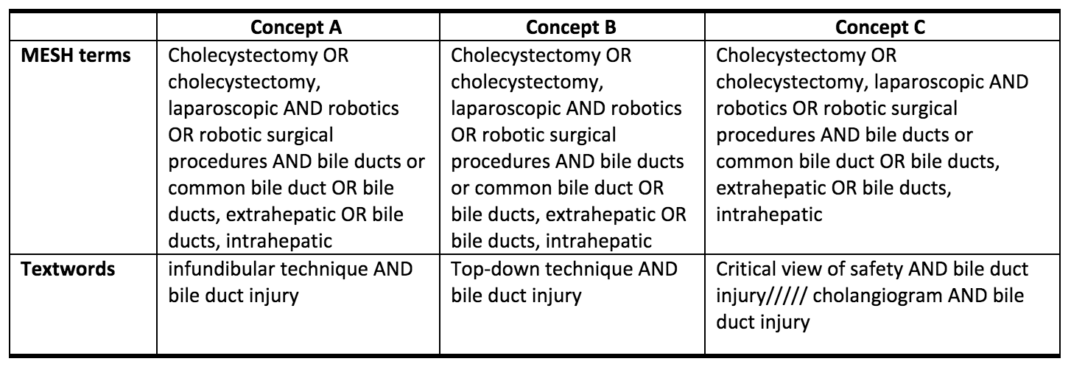
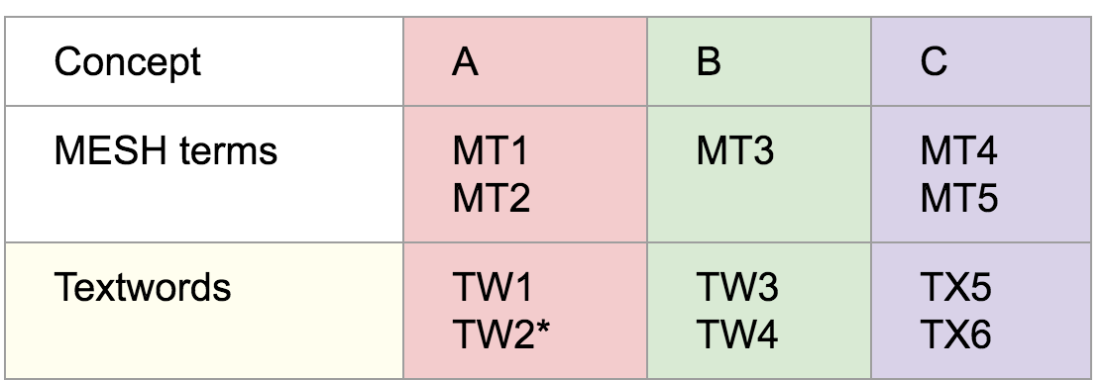
Literature Search

Slide 95
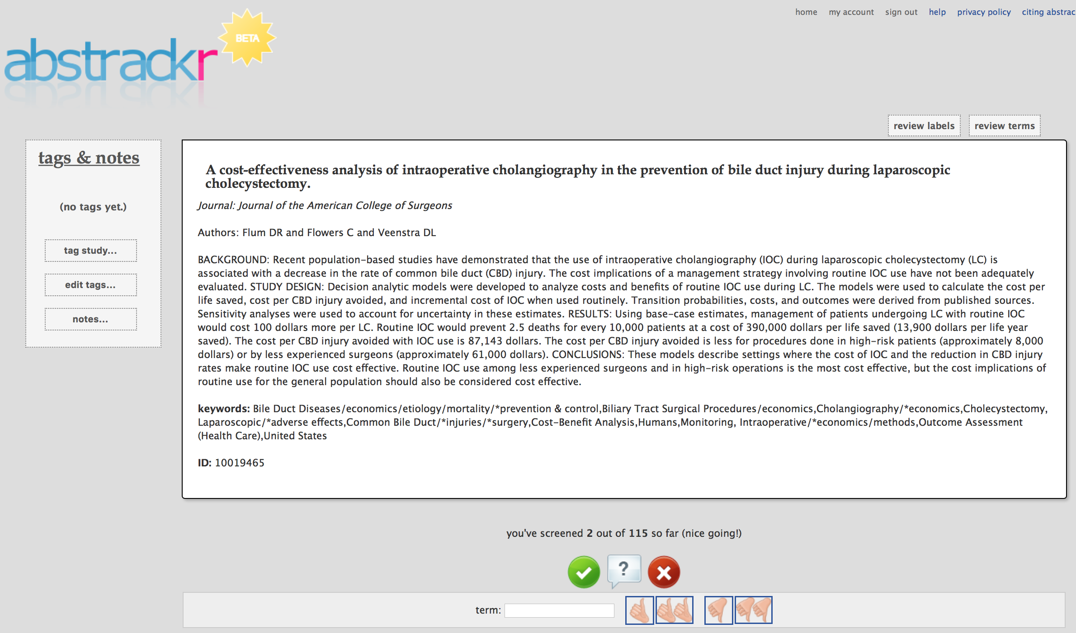
Abstract Review – Reviewer Calibration

Slide 96
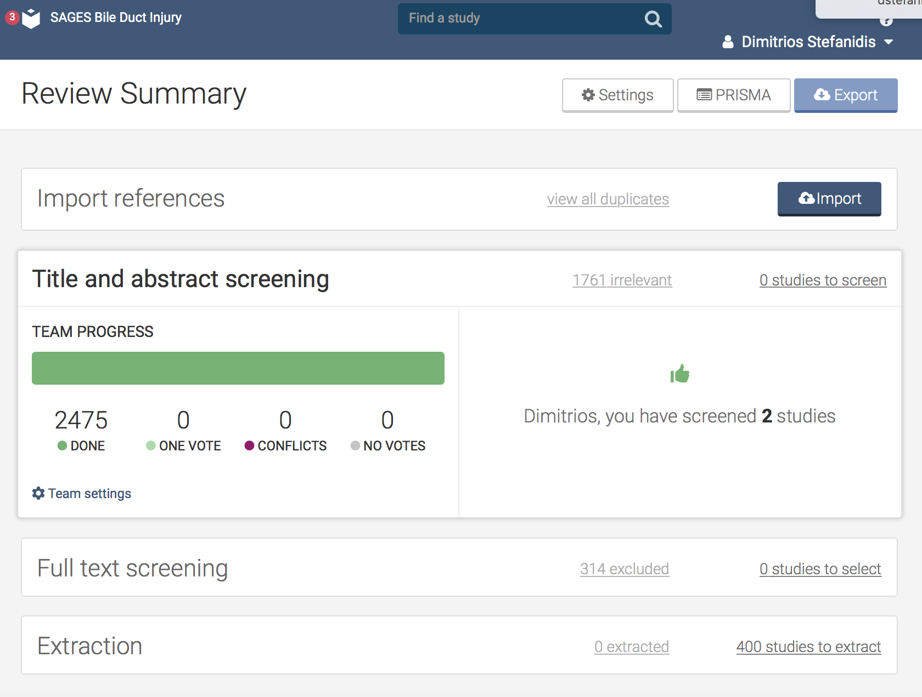
Abstract and Full Paper Review
2,475 abstracts screened
714 included
1761 excluded
714 full papers reviewed
400 extracted
314 excluded

Slide 97
Data Extraction

Slide 98
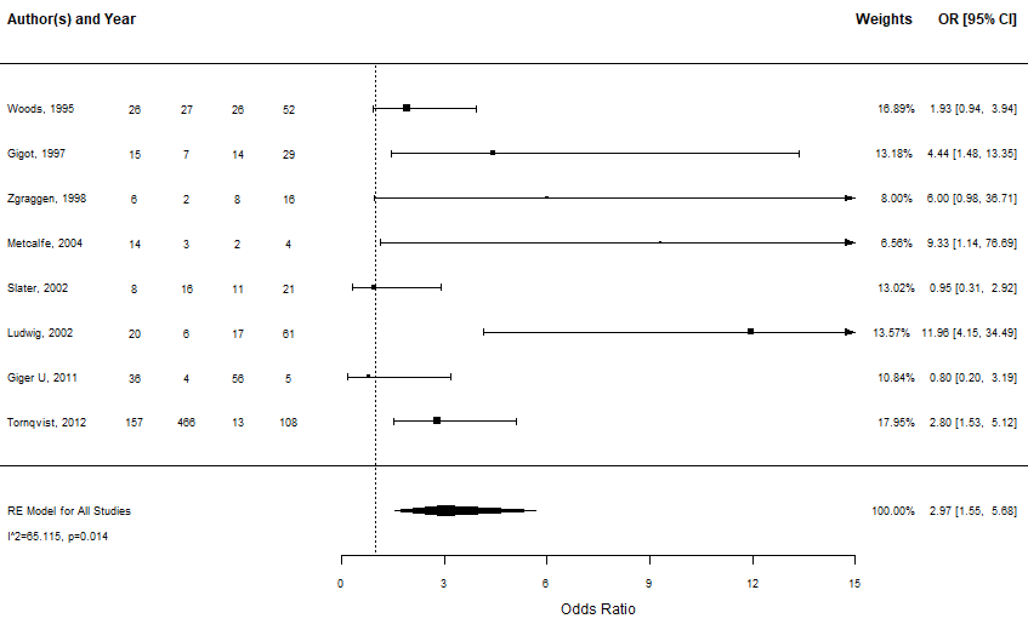
Data Analysis

Slide 99
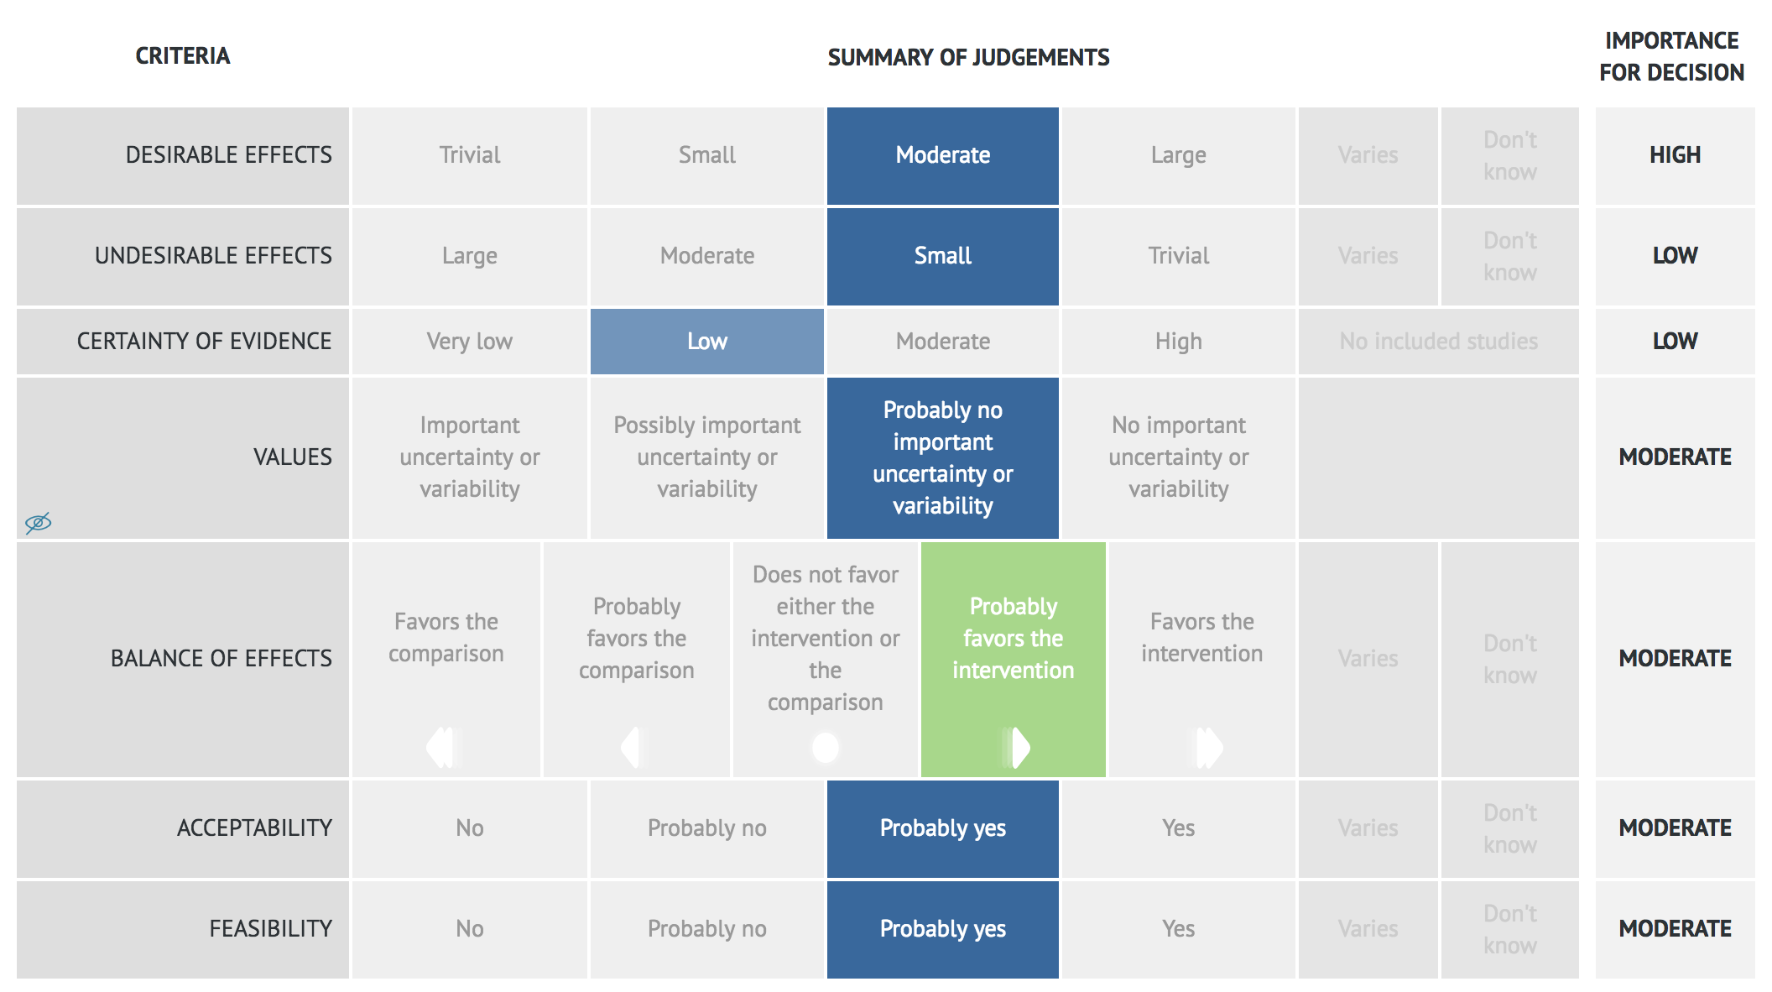

Slide 100
Recommendation Formulation
Recommendation
Justification
Subgroup considerations
Implementation considerations
Monitoring and Evaluation
Research Priorities

Slide 101
Recommendations
GRADE recommendations
Type B recommendations
Other non GRADE recommendations often related to future research
Did not consider cost
Focus on patients
Severely limited available evidence
Panel voting – social aspect/ stakeholder agreement
Low quality of evidence
>80% panel agreement in all recommendations

Slide 102
Expert Validation of Recommendations

Slide 103
Prevent BDI Consensus Conference

Slide 104
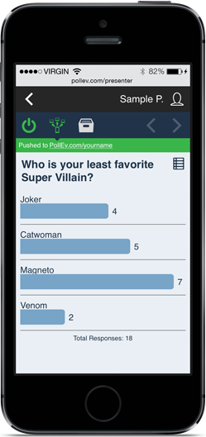
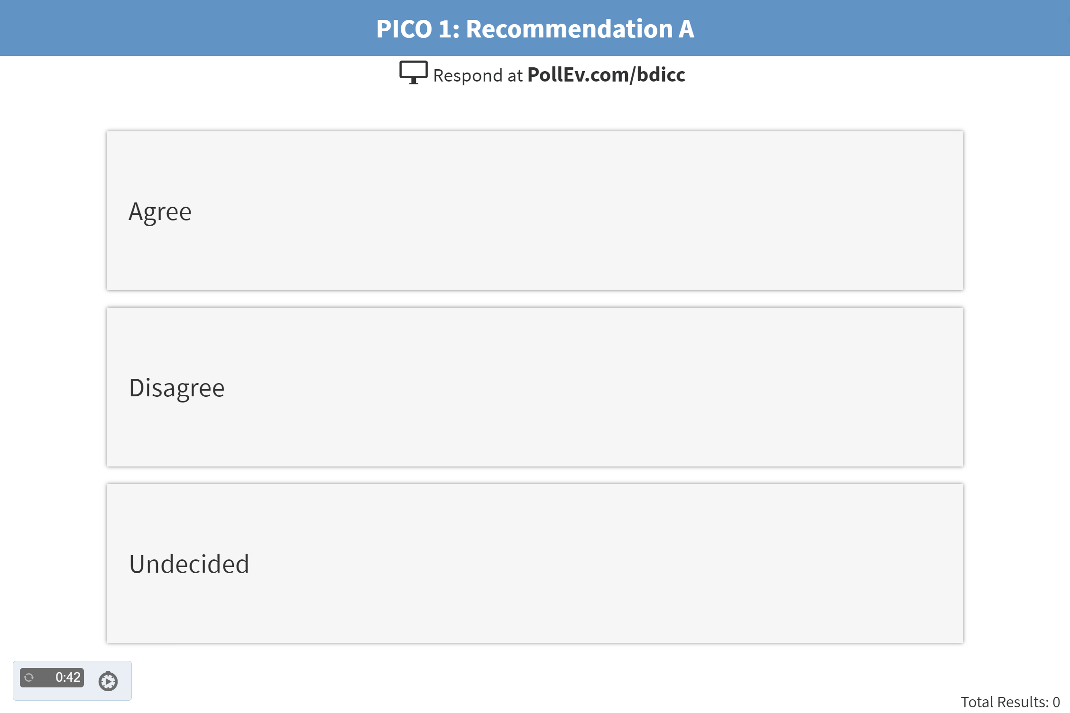
https://pollev.com/bdicc

Slide 105
Meeting and Voting Process
Presentation of PICO question/recommendation/justification and evidence
Voting by expert panel
Voting by audience (MD’s only)
If > 80% agreement by expert panel, recommendation is approved
If < 80% agreement by expert panel, discussion by expert panel
(open audience discussion after expert panel)
Revote or reconsider/revise for later consideration

Slide 106
Consensus Recommendations (from GRADE Handbook)
Two types of recommendations:
Strong - confident that the desirable effects of an intervention outweigh its undesirable effects (strong recommendation for an intervention) or that the undesirable effects of an intervention outweigh its desirable effects (strong recommendation against an intervention) Implies that most or all individuals will be best served by the recommended course of action.
Conditional – desirable effects probably outweigh undesirable effects or undesirable effects probably outweigh the desirable effects (weak recommendation against an intervention) but appreciable uncertainty exists Depending on patient values, resources available or setting
Panel should consider both the content and strength of the recommendation in voting

Slide 107
Consensus Recommendations for Future Studies: Type B Recommendations
Criteria:
There is insufficient evidence to support a decision for or against an intervention
Further research has large potential for reducing uncertainty about the effects of the intervention
Further research is thought to be of good value for the anticipated costs
Panel voting to help establish prioritization for the proposed studies
From GRADE Handbook
https://gdt.gradepro.org/app/handbook/handbook.html#h.w29yp7vuyzwo

Slide 108
Consensus Post Meeting
Recommendations posted for one month for public comment
https://www.preventbdi.org/

Slide 109
https://pollev.com/bdicc

Slide 110
Prevent BDI Consensus Conference

Slide 111
Workgroup I : PICOs #1 - 3
Co-leads: Marian McDonald, Daniel Deziel
Maria Altieri
Benjamin Veenstra
Justin Gerard
MacKenzie Landin
Ismael Dominguez-Rosado
Notes:
Deziel: Acknowledge workgroup. Introduce presentations by Dr Altieri & Dr. McDonald. Format: PICO question, recommendation, summary of literature reviewed & evidence/justification for rec. Back to recommendation slide for discussion/voting.

Slide 112
PICO # 1
Should the critical view of safety (CVS) vs. other methods (e.g. infundibular, top down, or intraoperative cholangiography) be used to mitigate the risk of bile duct injury during laparoscopic cholecystectomy?

Slide 113
PICO #1: Method Anatomic Identification
Recommendation
In patients undergoing laparoscopic cholecystectomy,
we suggest that surgeons use the critical view of safety
for anatomic identification of the cystic duct and cystic artery.
Conditional recommendation
Very low certainty of evidence

Slide 114
PICO # 1: Method Anatomic Identification: Summary of Literature Reviewed
3 Systematic Reviews (2002-2011)
1 Prospective RCT (2011)
1 Retrospective Comparative Study (2011)
12 Single Arm Cohort Studies (1991-2017)
4 Case Series (2000-2014)
6 Survey Studies (1997-2018)
7 Expert Opinion Papers (2002-2018)
Insufficient for meta analysis
Notes:
This is a summary of the literature reviewed for PICO #1. There were 3 systematic reviews, none of which were particularly high quality or recent. R-AMSTAR is a tool that evaluates the quality of systematic reviews on a numerical scale from 11 – 44. The R-AMSTAR scores of these reviews were 11, 18, & 23. There were no direct comparative studies that provided strong evidence. The majority of evidence is from single arm cohort studies or case series. The literature was not sufficient for meta analyis.

Slide 115
PICO # 1: Indirect evidence for CVS
Using CVS, large institutional studies demonstrate lower than expected rates of bile duct injury.
Observed rate : 0 – 0.07%
Expected rate : 0.2 – 0.4%
O/E = 0.125 – 0.25
Palanivelu, 2007 N = 9,864 0.07% BDI
Yegiyants, 2008 N = 3,042 0 BDI
Avgerinos, 2009 N = 998 0 BDI
Tsalis, 2015 N = 873 0 BDI
Notes:
Support for the use of the CVS comes two lines of indirect evidence. First, there are several large single institutional studies that report routine use of the CVS, and have a BDI rate that is either nonexistent, or lower than what has typically been reported.

Slide 116
PICO # 1: Indirect evidence for CVS
2. Combined cohort studies using CVS demonstrate a lower rate of BDI
compared to combined cohort studies using infundibular approach.
CVS: 1 BDI/5,421 cases (0.018%)
Infundibular: 5 BDIs/6,810 cases (0.07%)
Notes:
Also, if you combine single arm cohort studies, the reported rate of BDI is lower when the CVS is used compared to when the infundibular approach is the primary method described. The limitation of these studies is that the actual method used is not documented beyond it being the routine practice.

Slide 117
PICO # 1: Indirect evidence for CVS
3. Case series of bile duct injuries with analysis of mechanism of injury (videos, OR reports) do not document use of critical view of safety
Booij, 2014 528 BDIs: CVS documented in 33 (6.3%)
Nijssen, 2015 11 BDIs with video: No CVS
Strasberg, 2000 21 BDIs: No CVS
Notes:
The second line of evidence in support of the CVS comes from case series of BDIs that have carefully analyzed the mechanism of injury based on operative reports and, in some cases, videos. These find that in cases where a BDI has occurred, the method for anatomic identification was nearly always something other than the CVS.

Slide 118
PICO # 1: Undesirable effects of CVS
Little evidence that CVS, or attempt to achieve CVS, is associated with undesirable effects
One report of 600 selected LCs with 7 BDIs:
1 BDI occurred while dissecting CVS
Kohn, 2017
Notes:
There appears to be negligible downside to use of the CVS, it may require a little more dissection, which is precisely its value for secure identification. Since the term CVS was introduced 23 years ago (1995), we found one report of a BDI that occurred when the surgeon was attempting to achieve the CVS.

Slide 119
PICO #1: Data Summary Laparoscopic Top Down (Fundus-First) Method
Combined 13 cohort studies/ 1,181 cases : Deemed “safe & effective” in difficult cases based on conversion rate and complications (BDI rate not specified).
Prospective randomized trial “contracted” GB:
33 fundus-first vs. 31 standard LC
BDI 0 2
Complications 1 10
Conversion 0 7
(Huang, 2011)
Notes:
As far as the laparoscopic top-down, or fundus-first, method for anatomic identification, there is little direct comparative data. In “difficult” cases, it has been reported to be a “safe and effective” alternative to total cholecystectomy by a hilar first dissection, although the rate of BDI is not specifically reported. There is one underpowered study from China that randomized patients with a contracted GB by ultrasonographic criteria to a top down or standard hilar first approach and found fewer BDIs, complications and conversions with the top down approach.

Slide 120
PICO #1: Data Summary Laparoscopic Top Down ( Fundus First) Method
3. Case series 30 laparoscopic BDIs (plus 152 open chole BDIs) found all occurred with hilar first (vs. fundus-first)dissection. Yang, 2002
4. Case series 8 “extreme” vasculobiliary injuries found all occurred with fundus-first dissection after lap converted to open. Strasberg, 2012
Notes:
Another case series of BDIs from found that all their cases of BDIs had occurred with a hilar first approach. On the other hand, a case series of extreme combined vascular and bile duct injuries found that all occurred with a top down dissection (after lap converted lap cases).

Slide 121
PICO #1: Data Summary Intraoperative Imaging Methods for Anatomic Identification
IOC use associated with fewer BDIs, lower severity BDI, more frequent intraoperative detection of BDI.
Causal relationship not conclusive.
2. Laparoscopic ultrasonography may prevent BDI in difficult cases.
12 studies/7,905 cases.
Note: Additional data on intraoperative imaging addressed in PICO # 4
Notes:
Intraoperative imaging will be specifically addressed in PICO question #4, but there is indirect evidence that IOC or laparoscopic ultrasound might mitigate BDI.

Slide 122
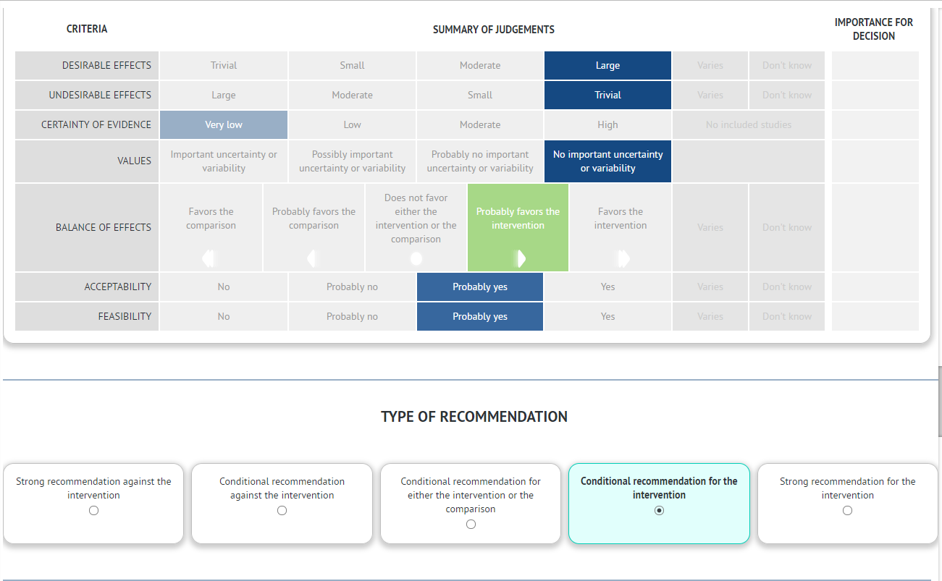
PICO #1: Use of CVS
Notes:
In summary, there is no level 1 evidence that supports one method for anatomic identification over another. However, a conditional recommendation can be made based on the indirect evidence and supported by expert opinion. This table summarizes the judgements used in grading the evidence. Considering the CVS as the intervention: the desirable effect of avoiding BDI is large. The undesirable effects are trivial. The certainty of evidence is graded very low because there are no valid direct comparative studies and it is largely driven by expert opinion. There is no uncertainty about the value of avoiding BDI. The intervention is probably favored. It is also probably acceptable and feasible. Hence, it is a conditional recommendation.

Slide 123
PICO #1: Recommendation
In patients undergoing laparoscopic cholecystectomy,
we suggest that surgeons use the critical view of safety
for anatomic identification of the cystic duct and cystic artery.
Conditional recommendation
Very low certainty of evidence
Additional consideration : When the CVS cannot be achieved safely (e.g. due to pathologic alterations of, or native variations in, biliary anatomy,
we suggest that surgeons consider intraoperative imaging for anatomic identification.
Notes:
Read rec again. An important additional consideration, not included in the wording of the recommendation itself, is that when the CVS cannot be safely achieved, we suggest that surgeons consider intraoperative imaging. This recommendation is now open for discussion.

Slide 124
Vote on PICO 1 Recommendation

Slide 125
PICO # 2
Should the top down technique of total cholecystectomy versus subtotal cholecystectomy be used to mitigate the risk of bile duct injury when critical view of safety cannot be achieved during laparoscopic cholecystectomy?

Slide 126
PICO #2: Top Down vs. Subtotal Recommendation
When the critical view of safety cannot be achieved and the biliary anatomy cannot be clearly defined by other methods (e.g. imaging) during laparoscopic cholecystectomy, we suggest that surgeons consider subtotal cholecystectomy over total cholecystectomy by the top down approach.
Conditional recommendation
Very low certainty of evidence

Slide 127
PICO #2: Subtotal vs. Top down Summary of Literature Reviewed
2 Systematic Reviews (2011, 2015): 30 unique studies
10 additional cohort studies (1993- 2017)
1 Prospective RCT (2011)
2 Administrative database studies (2012, 2017)
2 case series (2002, 2011)
Insufficient for meta analysis
Note: Additional data on subtotal cholecystectomy addressed in PICO #9
Notes:
This is a summary of the literature reviewed. Neither of the systematic reviews were high quality by R-AMSTAR criteria (scores 18 & 21, scale from 11 – 44). Most of the literature consisted of single arm cohort studies. There was one small RCT. There were 2 administrative database studies and 2 case series. The literature was not sufficient for meta analysis. Additional information on subtotal cholecystectomy will also be addressed in PICO question #9.

Slide 128
PICO # 2: Data Summary Laparoscopic Top Down (Fundus First) Method
Combined 13 cohort studies/ 1,181 cases : Deemed “safe & effective” in difficult cases based on conversion rate and complications (BDI rate not specified).
Prospective randomized trial “contracted” GB:
33 fundus-first vs. 31 standard LC
BDI 0 2
Complications 1 10
Conversion 0 7
(Huang, 2011)
Notes:
The next 2 slides regarding top down, or fundus first, cholecystectomy were already presented in PICO #1. There is indirect support for top down dissection in selected cases.

Slide 129
PICO # 2: Data Summary Laparoscopic Top Down (Fundus-First) Method
3. Case series 30 laparoscopic BDIs (plus 152 open chole BDIs) found all occurred with hilar first (vs. fundus-first)dissection. Yang, 2002
4. Case series 8 “extreme” vasculobiliary injuries found all occurred with fundus-first dissection after lap converted to open. Strasberg, 2012
Notes:
However, there is also a cautionary tale of severe vascular and biliary injuries occurring with the top down approach.

Slide 130
PICO # 2: Data Summary Laparoscopic Subtotal Cholecystectomy
1. 1,868 lap subtotals from 39 studies
BDI: 2/1,460 cases (0.14%)
Conversion: 202/1,850 cases (10.9%)
2. Administrative database studies
a) UHS Consortium: Lap Subtotal (N = 487) vs. Lap Total (N = 131,082)
1:1 propensity score match: no difference mortality, LOS, readmits
(Kim, 2017)
b) NIS: 3.3% BDI (360/10,872) cases lap subtotal, open subtotal &
“trocar” cholecystostomy. No difference in BDI between laparoscopic
vs. converted subtotal cholecystectomy (Lee, 2012)
Notes:
This slide summarizes the data on laparoscopic subtotal cholecystectomy. Combined cohort studies report a BDI rate of 0.14%. An administrative database study from the UHS Consortium tried to compare lap subtotal with lap total cholecystectomy in propensity matched patients and found no differences in mortality, LOS or readmissions, but did not specify BDI. A study from the National Inpatient Sample looked at “damage control” operations defined as laparoscopic or open subtotal cholecystectomy or “trocar cholecystostomy”. The BDI rate was 3.3% but was not compared between the procedures. There was no difference in BDI rate between subtotals performed laparoscopically or subtotals that were converted. All of these data on laparoscopic subtotal cholecystectomy are limited in terms of their generalizability.

Slide 131
PICO # 2: Literature Summary
No direct comparative studies of laparoscopic subtotal vs. laparoscopic top down total cholecystectomy.
Each has been safely performed in selected cases.
Each has been associated with morbidity in some cases.
4. There are no standardized selection criteria as to
when these methods are best applied.
Notes:
To quickly summarize, there are no studies that directly compare laparoscopic subtotal cholecystectomy to laparoscopic top down total cholecystectomy. While both have been safely performed, each has potential morbidity for BDI or future biliary events. There are no standardized criteria for application.

Slide 132
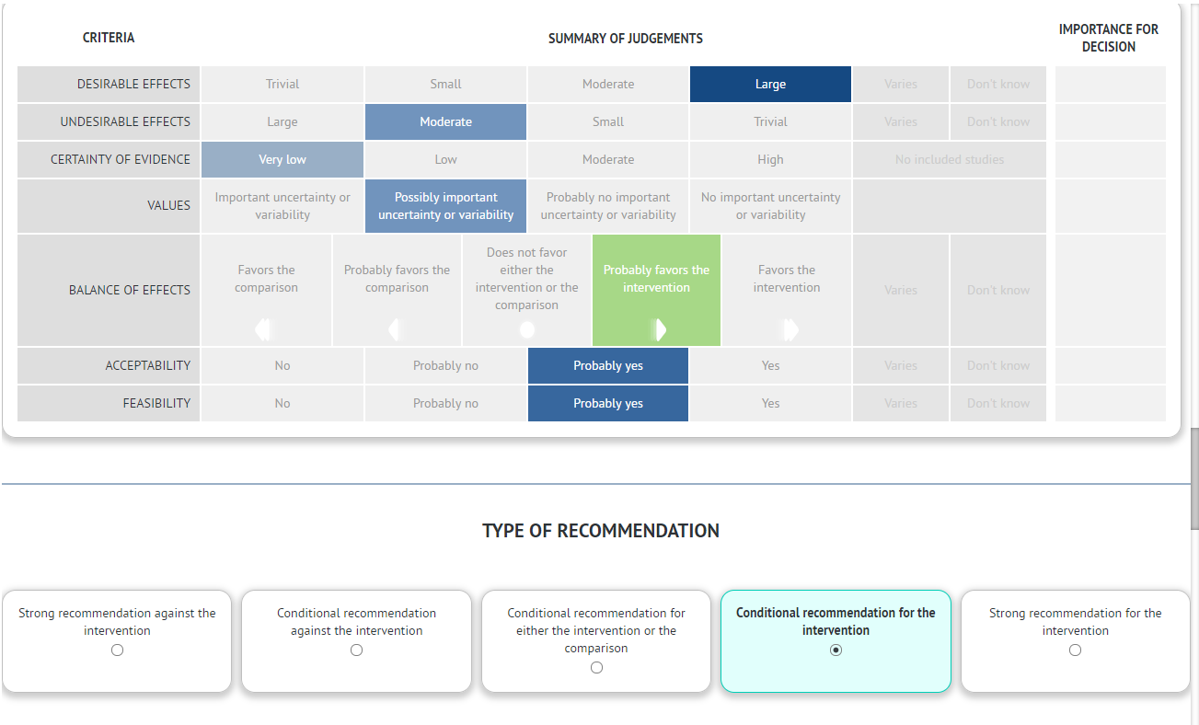
PICO #2: Top down vs. subtotal
Notes:
The summary table for recommendation. The desirable effect of avoiding BDI is large. However, the potential undesirable effects of either subtotal or top down cholecystectomy are also probably moderate or even large. The certainty of evidence is very low, primarily expert opinion. There is possibly important uncertainty about the value of either approach. If the intervention is subtotal cholecystectomy, it is favored over top down total cholecystectomy if the hepatocystic triangle cannot be safely dissected. This is a conditional recommendation.

Slide 133
PICO #2: Top Down vs. Subtotal Recommendation
When the critical view of safety cannot be achieved and the biliary anatomy cannot be clearly defined by other methods (e.g. imaging) during laparoscopic cholecystectomy, we suggest that surgeons consider subtotal cholecystectomy over total cholecystectomy by the top down approach.
Conditional recommendation
Very low certainty of evidence
Notes:
Read rec again and open discussion.

Slide 134
Vote on PICO 2
Recommendation

Slide 135
PICO # 3
How should the critical view of safety be documented during laparoscopic cholecystectomy (still doublet photos vs. operative notes vs. video vs. no documentation) ?

Slide 136
PICO # 3: Documentation of CVS Recommendation
When performing laparoscopic cholecystectomy, we suggest that surgeons incorporate documentation of the critical view of safety by doublet photography or video in addition to written documentation.
Conditional recommendation
Very low certainty of evidence

Slide 137
PICO #3: Documentation of CVS Summary of Literature Reviewed
5 Cohort Studies
1 Survey Study
Insufficient for meta analysis
Notes:
The literature pertaining to documentation of the CVS is sparse & insufficient for meta analysis.

Slide 138
PICO # 3: Documentation of CVS : Data Summary
5 cohort studies/368 cases: No BDIs.
Description of CVS in OR dictations is poor compared to photos or video.
Videos superior to OR notes (Wauben 2011, Plaisier 2001) and to CVS photos with 2 views (Emous 2010).
CVS photos with 2 views were superior to photos with one view (Sanford 2014).
IOC superior to CVS photos with one view (Buddingh 2012).
Survey study: surgeons using CVS. 80% document in OR report, 43% by photo, 30% by video (Buddingh 2011).
Notes:
The description of the CVS in written OR reports is usually inadequate. Videos are felt to be the most accurate but may not be practical to store. Photographs with both anterior and posterior views (“doublet photo”) provide better documentation than one view. There is no direct link between documentation of the CVS and BDI.

Slide 139
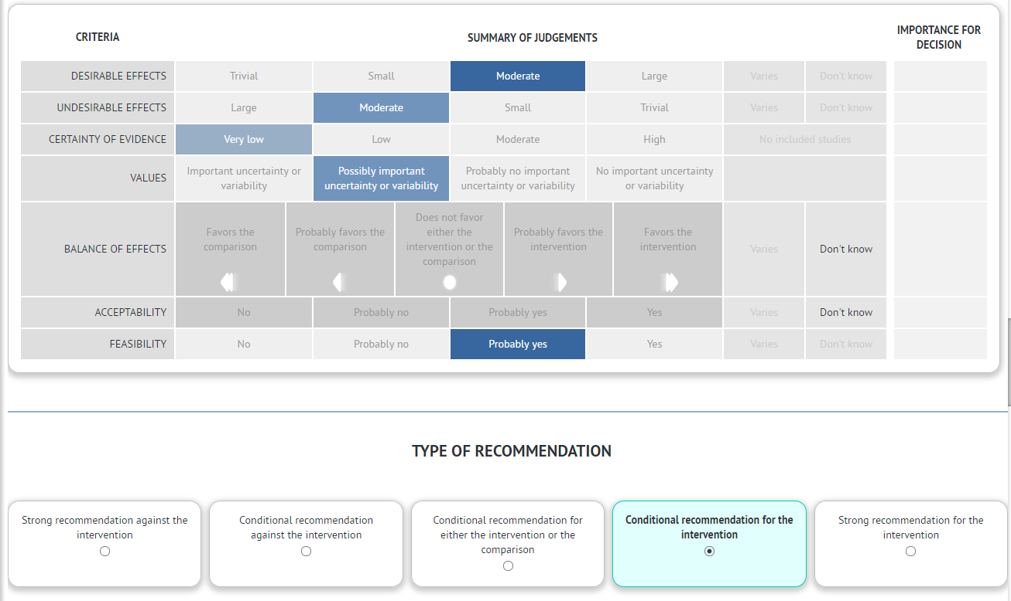
PICO # 3: Documentation CVS
Notes:
The desirable and undesirable effects are probably moderate. The certainty of evidence is very low. There is probably not uniform certainty of the value. Although documentation is feasible, it is controversial and the acceptability may be unknown.

Slide 140
PICO # 3: Documentation of CVS Recommendation
When performing laparoscopic cholecystectomy, we suggest that surgeons incorporate documentation of the critical view of safety by doublet photography or video in addition to written documentation.
Conditional recommendation
Very low certainty of evidence
Notes:
This recommendation is not intended to establish a mandate or a legal standard of care. The concerns about medico-legal implications are evident. The value of documentation for quality and teaching purposes is also evident. The intent of this recommendation would be to gradually introduce the process of documentation into surgical practice over time. We understand that this will be controversial and now welcome the discussion.

Slide 141
Vote on PICO 3
Recommendation

